Slide 1
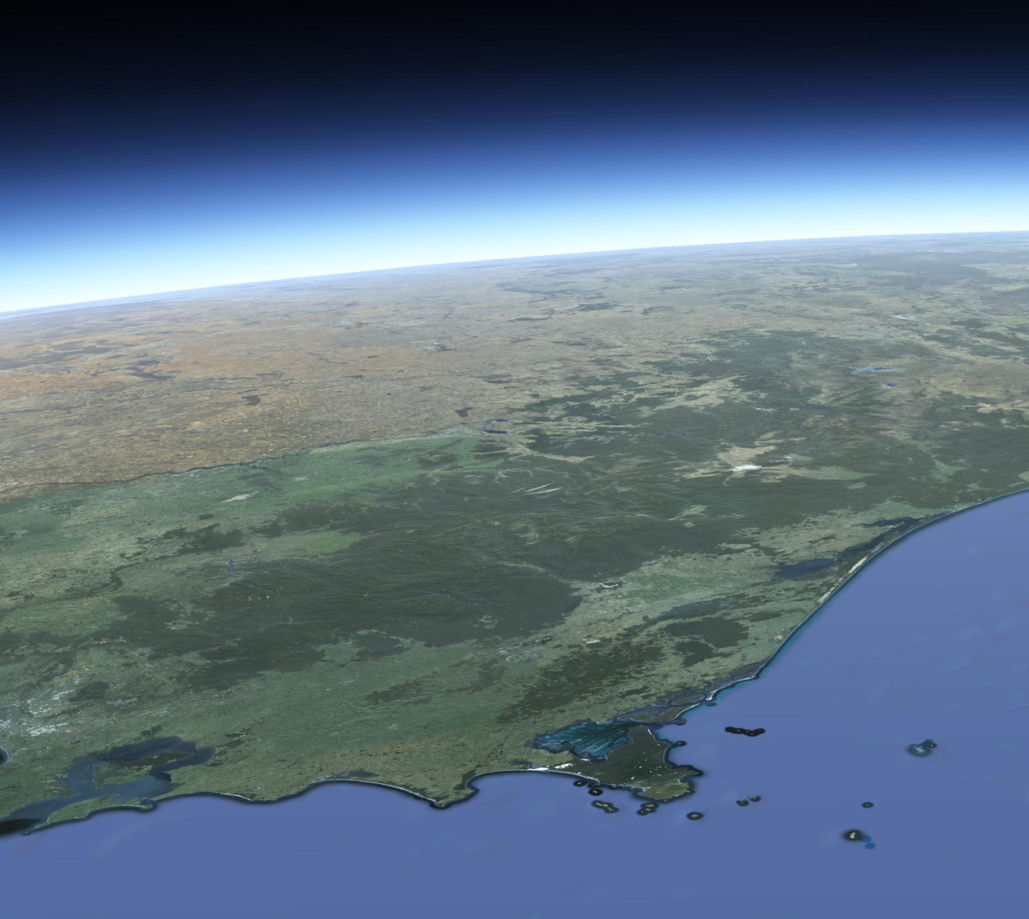
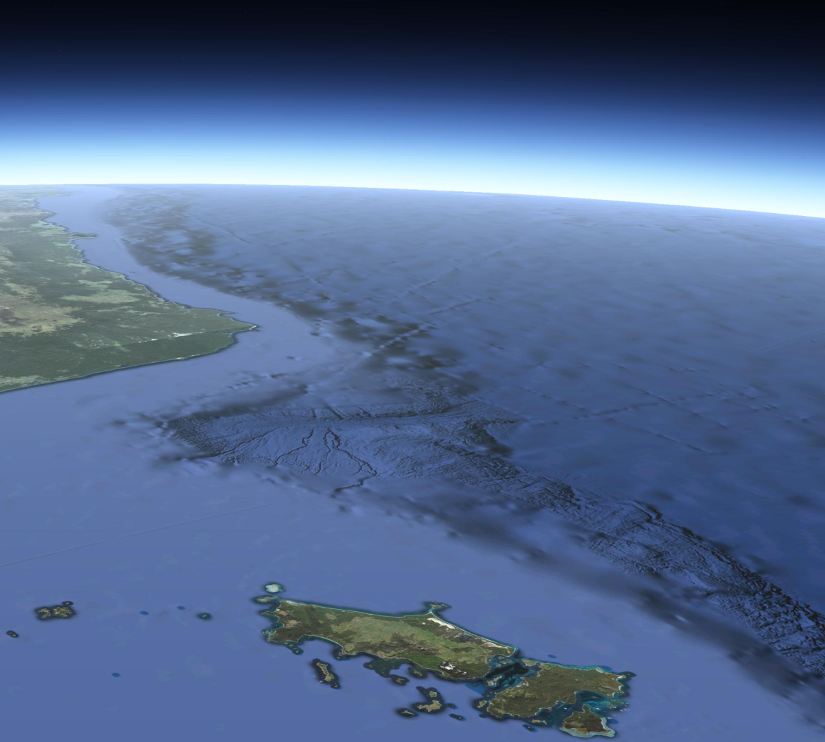
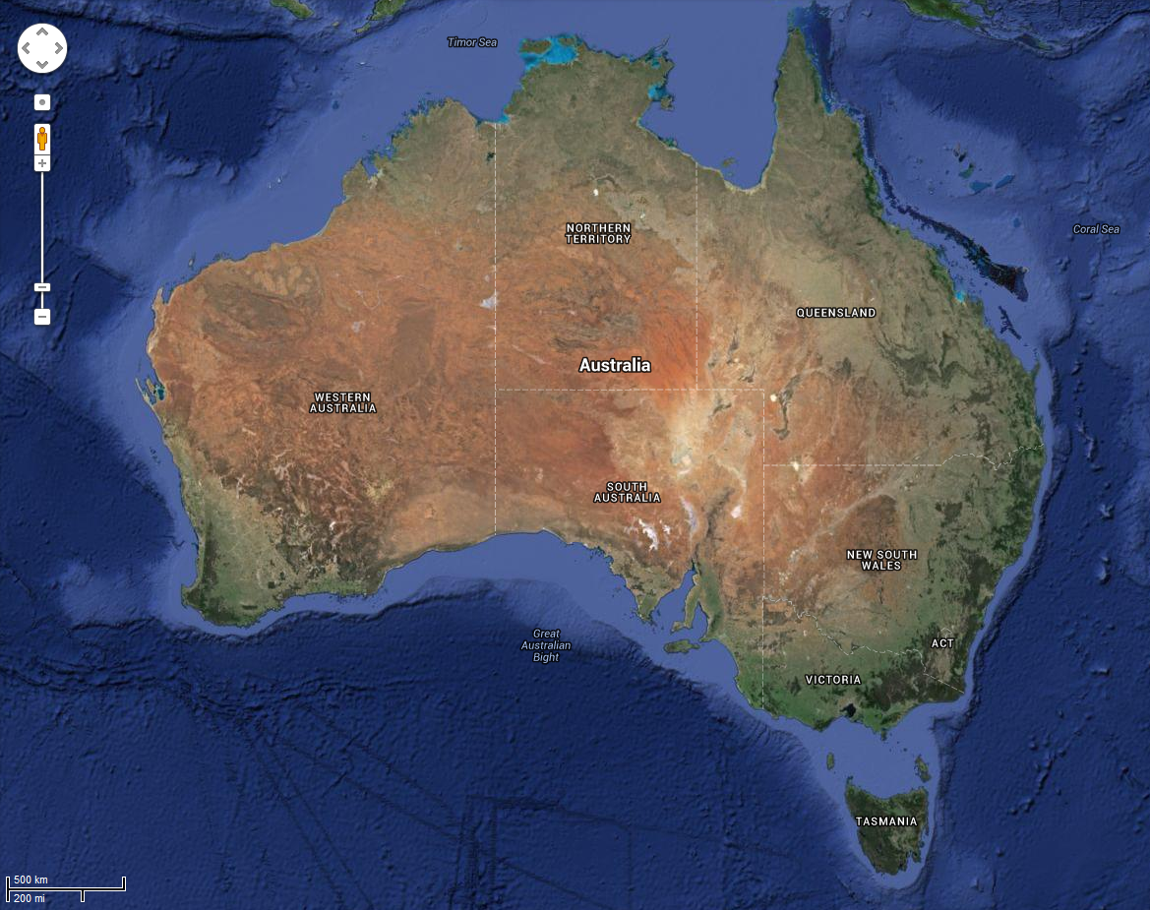
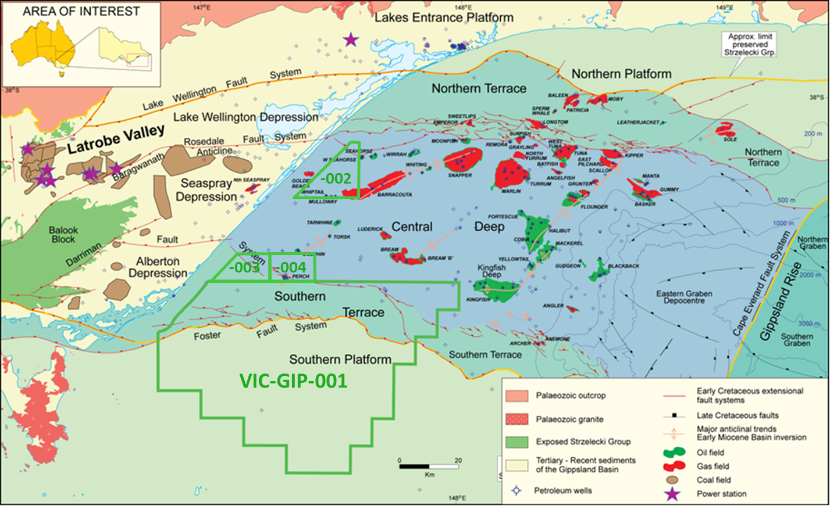
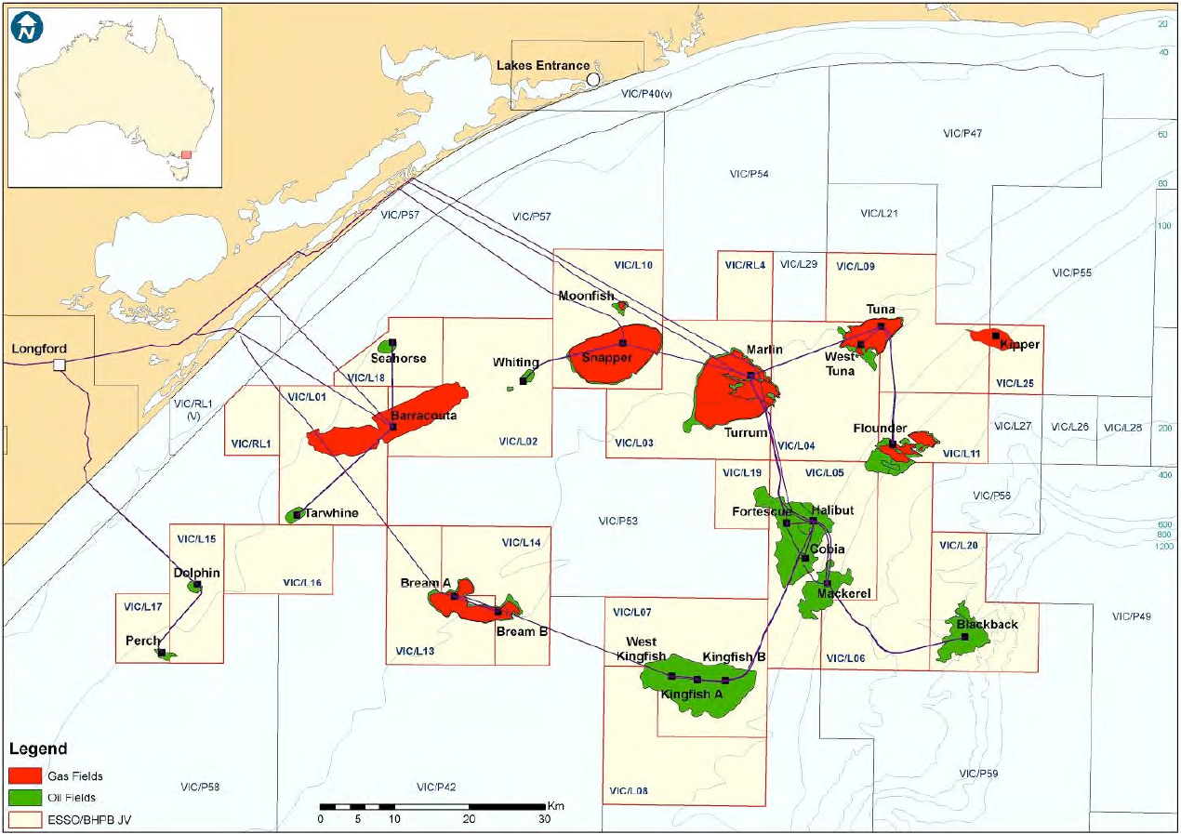
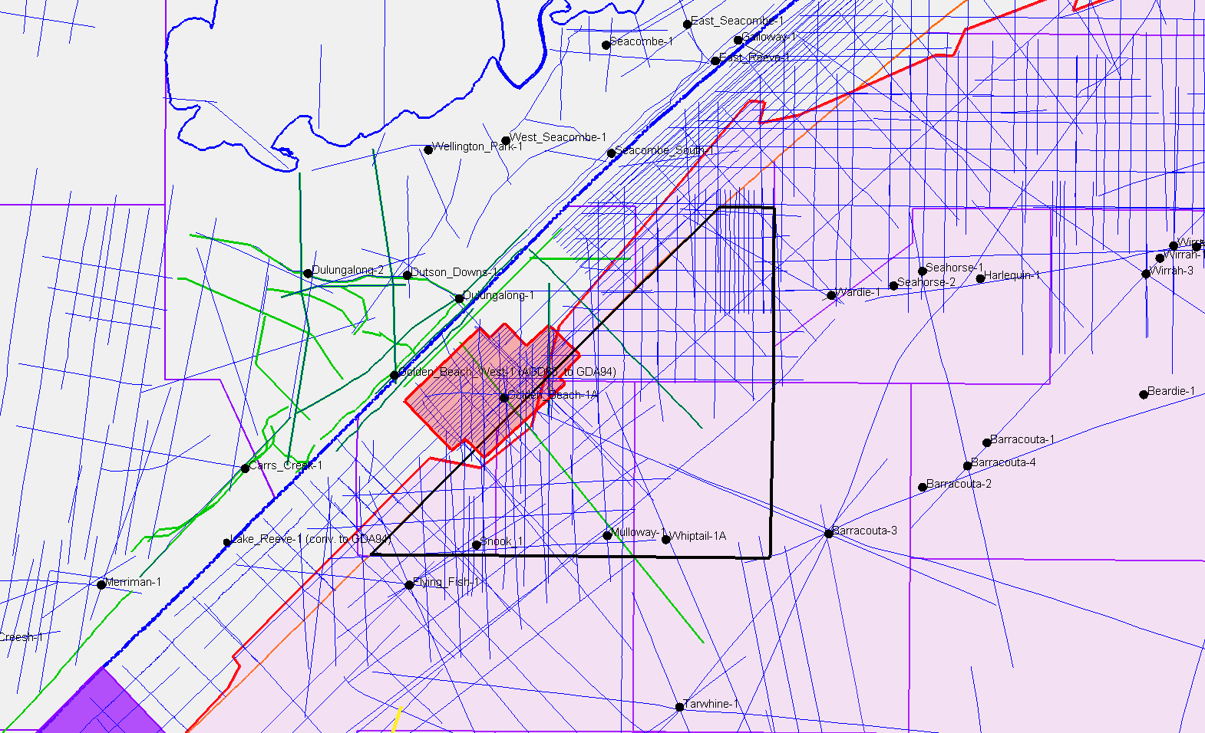
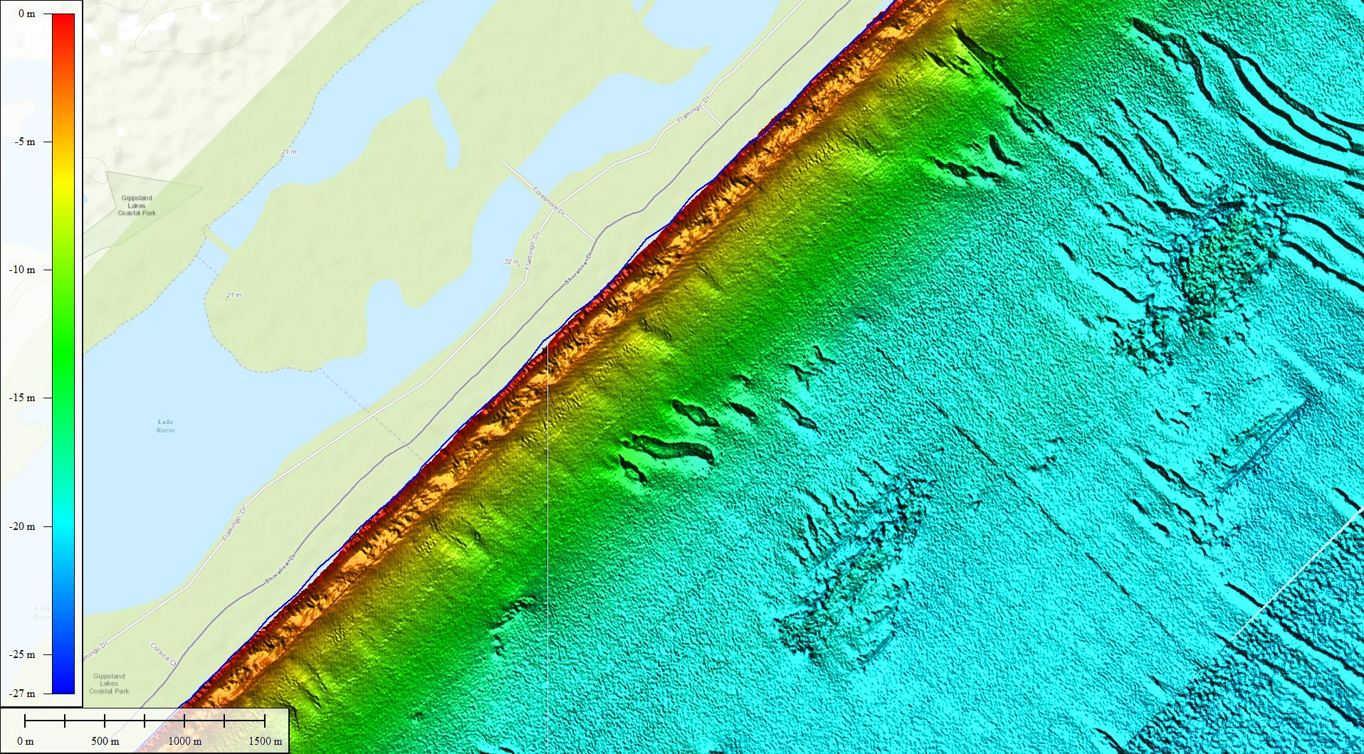
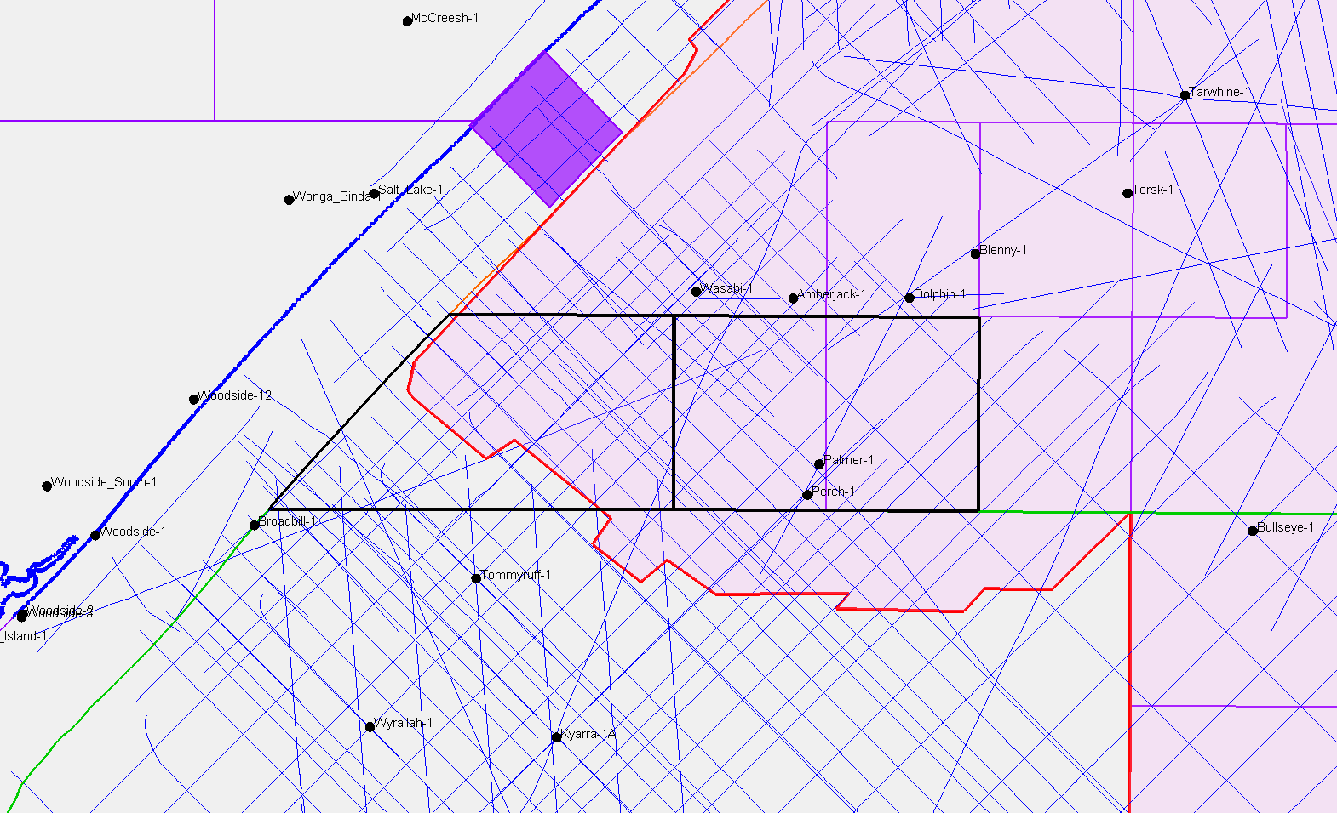
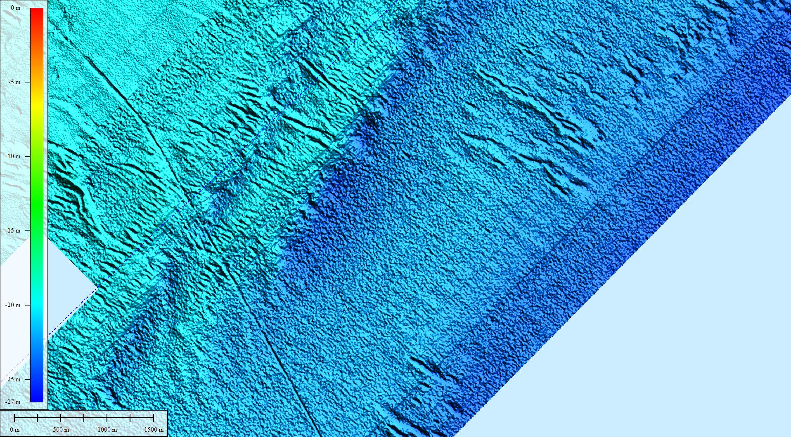
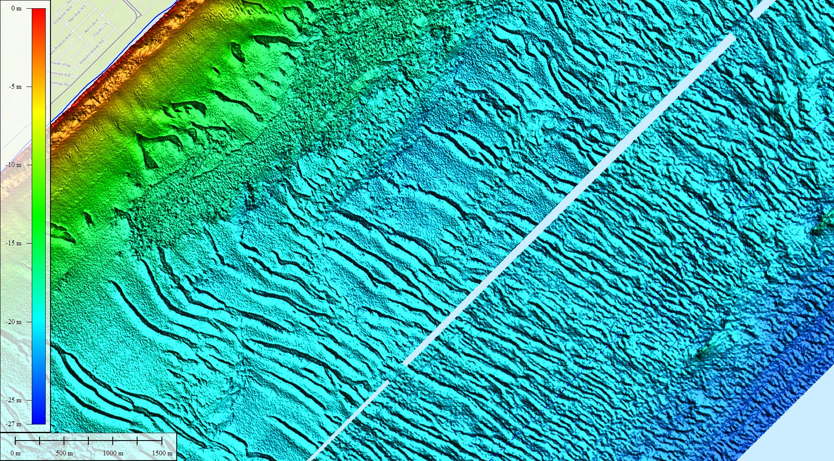
The CarbonNet Project
POSTER A
MMV constraints for shallow-water nearshore storage sites
Index Map:
Location of Gippsland Basin in Victoria, Australia
Image: Google Earth
Figure 3: Database.
Extensive seismic data has been collected during 50 years of petroleum exploration.
2D seismic lines (green and blue) have been superseded by extensive 3D seismic coverage in Commonwealth and State waters (lilac and red, respectively)
A marine park exists in state waters (purple).
Oil and gas tenements overlap with GHG permits held by CarbonNet (green). Approx. 50 wells are in the nearshore study area.
Figure 1: Basin Map.
The CarbonNet area of interest (blue dashed line) covers the nearshore Gippsland Basin out to approx. 25 km from the coastline, but avoiding major hydrocarbon accumulations. Basin architecture is a classic east-west rift basin with fill of fluvial clastics from the west and a shoreline backstepping over time from the eastern limit of the basin at ~80 Ma to behind the modern (intra-glacial) shoreline at ~25Ma, then advancing to the shelf edge at glacial lowstands. The northern and southern boundaries of the basin are fault-delimited and the rift section is thinned/partially eroded with poorer trapping potential.
Figure 2: Basin Infrastructure.
Extensive oil and gas exploration has culminated in several major field developments (platforms) and export pipelines. Over 1500 wells have been drilled. All petroleum infrastructure must be avoided in future CCS operations until such time as formal abandonment occurs. At this time, a new phase of re-use of depleted reservoirs may commence.
VIC-GIP-002
Nearshore MMV in the Gippsland Basin
The Gippsland Basin is Australia’s premier petroleum basin and has been explored for over 50 years. Basin reserves exceed 5 billion barrels of oil and 8 Tcf of gas.
CarbonNet is working-up sites in the nearshore for Carbon Storage and holds four GHG Assessment permits in Commonwealth waters (Figure 1). These permits cover several attractive targets with up to 125 Mt capacity.
The Gippsland basin has significant oil and gas infrastructure which must be avoided (Figure 2), but this industry activity has provided a data-rich opportunity with Abundant 3D seismic coverage offshore, and supporting 2D seismic in shallow water and onshore (Figure 3)
Water depths range from 15 to 50m in areas of CarbonNet interests. A Lidar survey was flown in 2008 by another government department for coastal mapping and flood prediction. The marine component offers 5m grids out to 3.5 km offshore and is supplemented by an oil industry LiDAR survey flown in 2004 to check bathymetry obstacles for a 3D seismic survey.
The Lidar grid (Figure 4) reveals complex seabed conditions with some mobile sand zones, local outcropping hardgrounds, and unusual distributory submarine channels with prominent levees that are currently believed to be related to the flushing of water from the adjacent lakes system, generating hypersaline density flows.
Anthropogenic features visible in the LiDAR bathymetry include pipeline trenches, outfall pipelines, and seabed trawl/dredge scars. (Figures 5-7).
Image: Google Earth
VIC-GIP-003
VIC-GIP-004
VIC-GIP-001
Figure 6: LiDAR detail – Outfall pipe.
At top right of the image is the SWOP saline water disposal outfall. The buried pipe has been scoured and concrete block supports are visible. A variety of natural seabed features are also imaged. These include oval patches of hardground 500m x 1 km – often misnamed as “reefs”. Distinctive diagonal “slashes” are distributory paired ridges with a central trough – interpreted as leveed channels originating from hypersaline outflows through the dune sands and porous seabed. A V-shaped feature pointing north-east at centre right of the image is interpreted as a trawl/dredge scar
Figure 5: LiDAR detail – Pipeline trench.
The prominent linear artificial feature on the left of the image is the trace of the 2002 TasGas pipeline trench. A variety of natural seabed features are also imaged. The largest of these are paired ridges with a central trough – perhaps a leveed channel?
Figure 7: LiDAR detail – Seabed scars and channels.
A strong development of leveed channels, downslope of a hardground with trawl scars and bedding outcrop.
Figure 4: LiDAR bathymetry.
A rich database of bathymetric textures and associated processes is derived from LiDAR swath mapping of the nearshore. This strip of data is rotated 45 degrees clockwise.
Victoria’s State Department of Sustainability and Environment commissioned a Fugro LADS survey over the nearshore in 2008-09 to a nominal 20m water depth or 3.5 km offshore (upper panel of data from orange surf zone to data splice.
2.5 m grids were produced oriented to grid north but original flight grid only resolved 5m, in swaths generally parallel to the coast. (Data striping is visible in ~200m swaths)
Fugro LADS also flew a commercial survey in 2004 to delineate seabed obstructions for a 3D seismic survey reaching towards shallower water (lower panel of data, gridded at 5m resolution). Several rocky outcrops and hardgrounds were mapped by LiDAR and safely avoided during the survey.
The CarbonNet Project
CarbonNet is run by the State Government of Victoria, with funding support from the Federal government under the Greenhouse Gas Flagships Programme and from the GCCSI.
www.energyandresources.vic.gov.au/carbonnet

