Slide 1
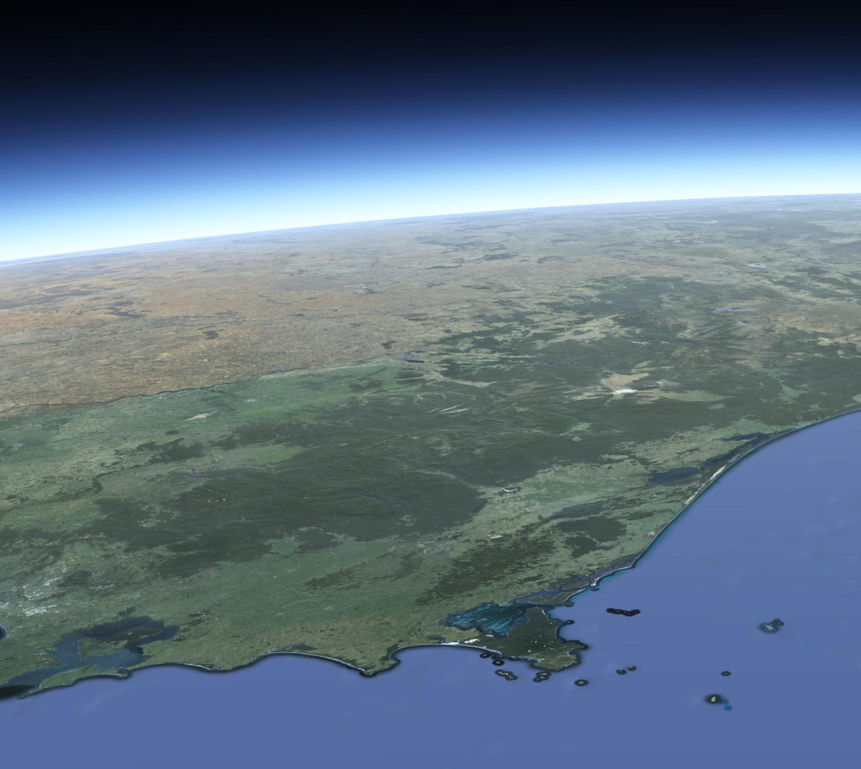
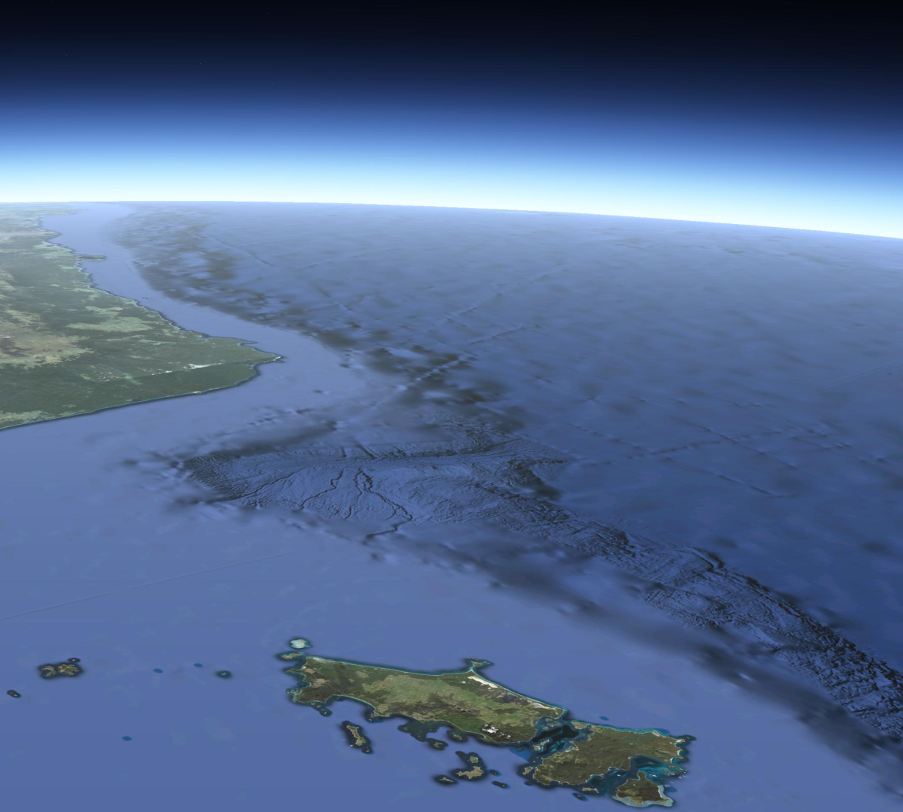
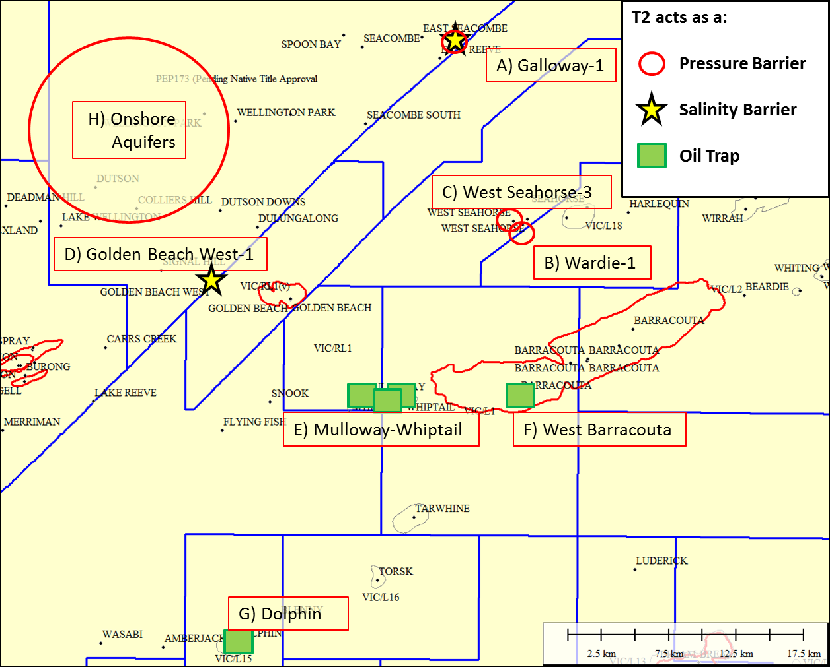
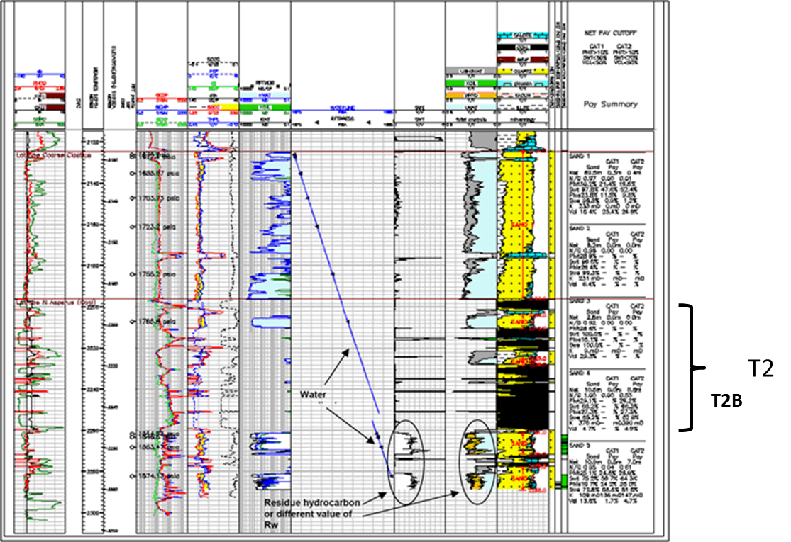
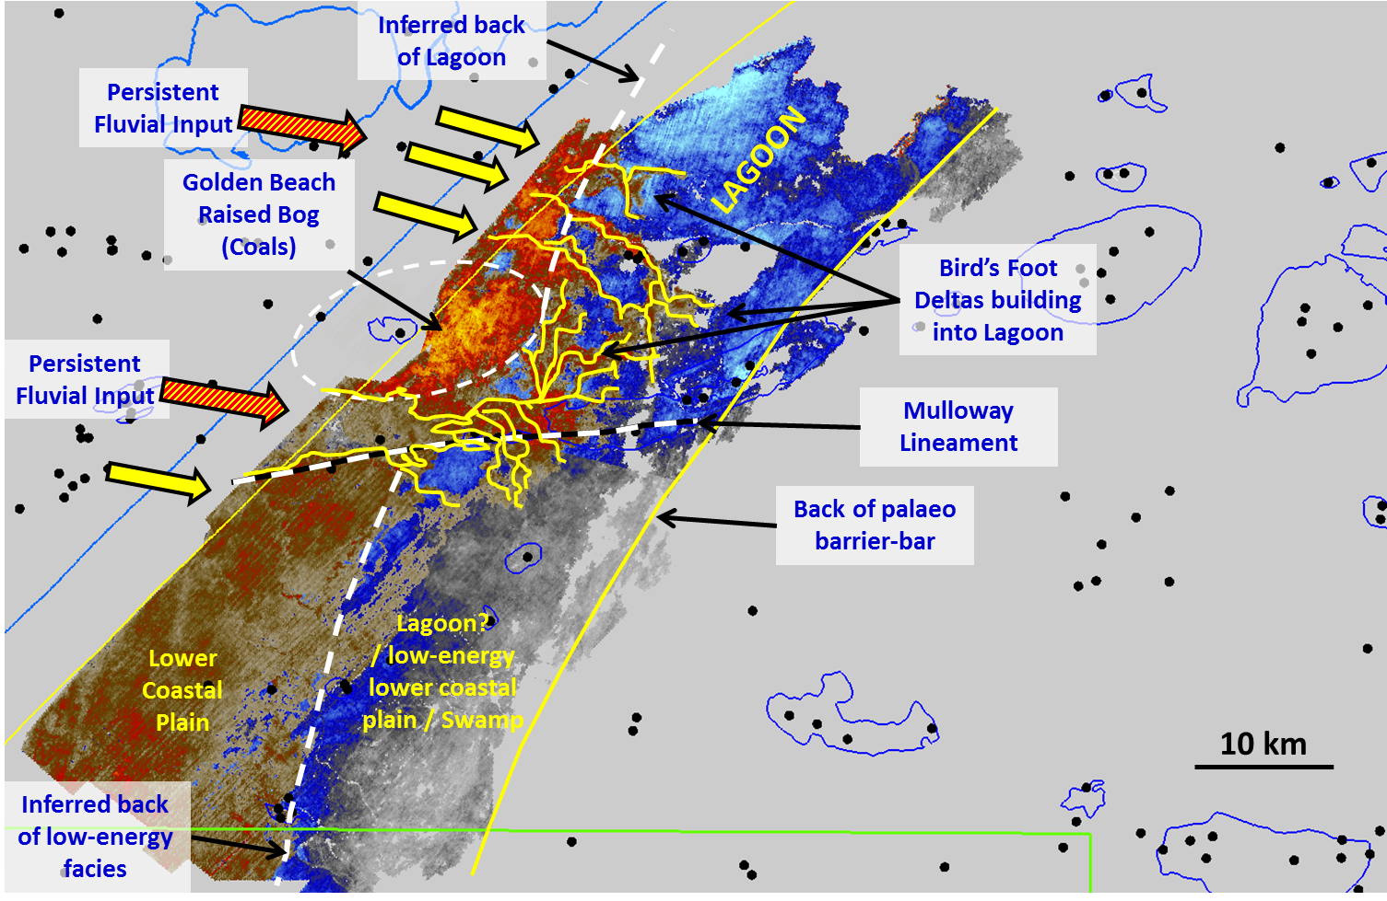
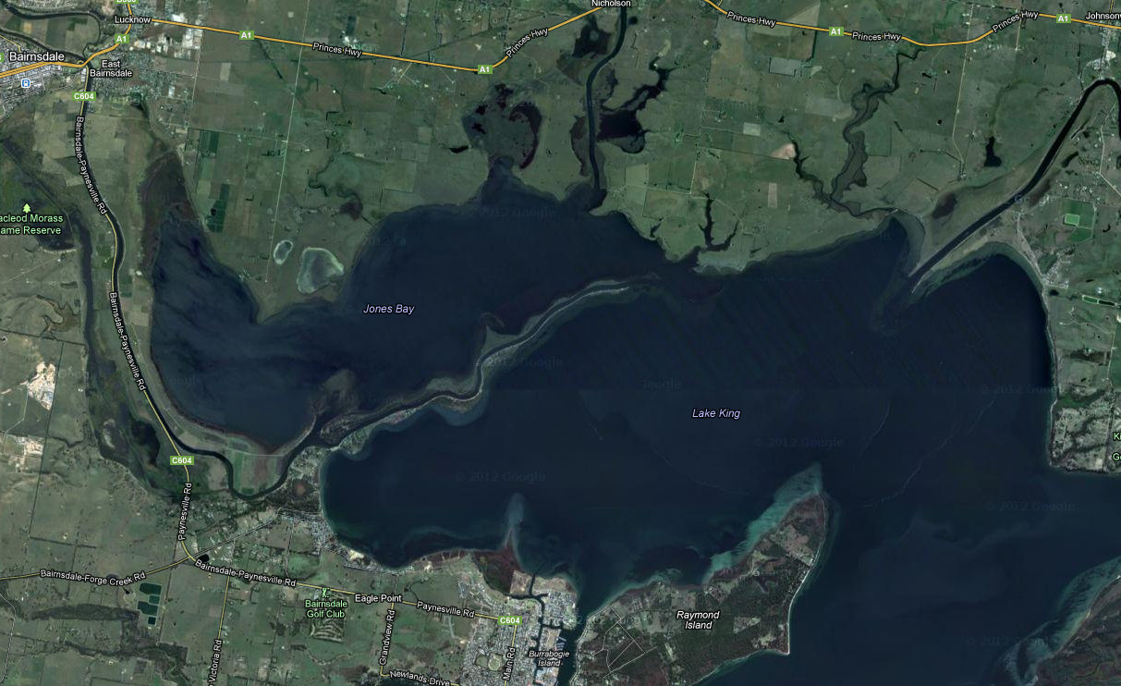
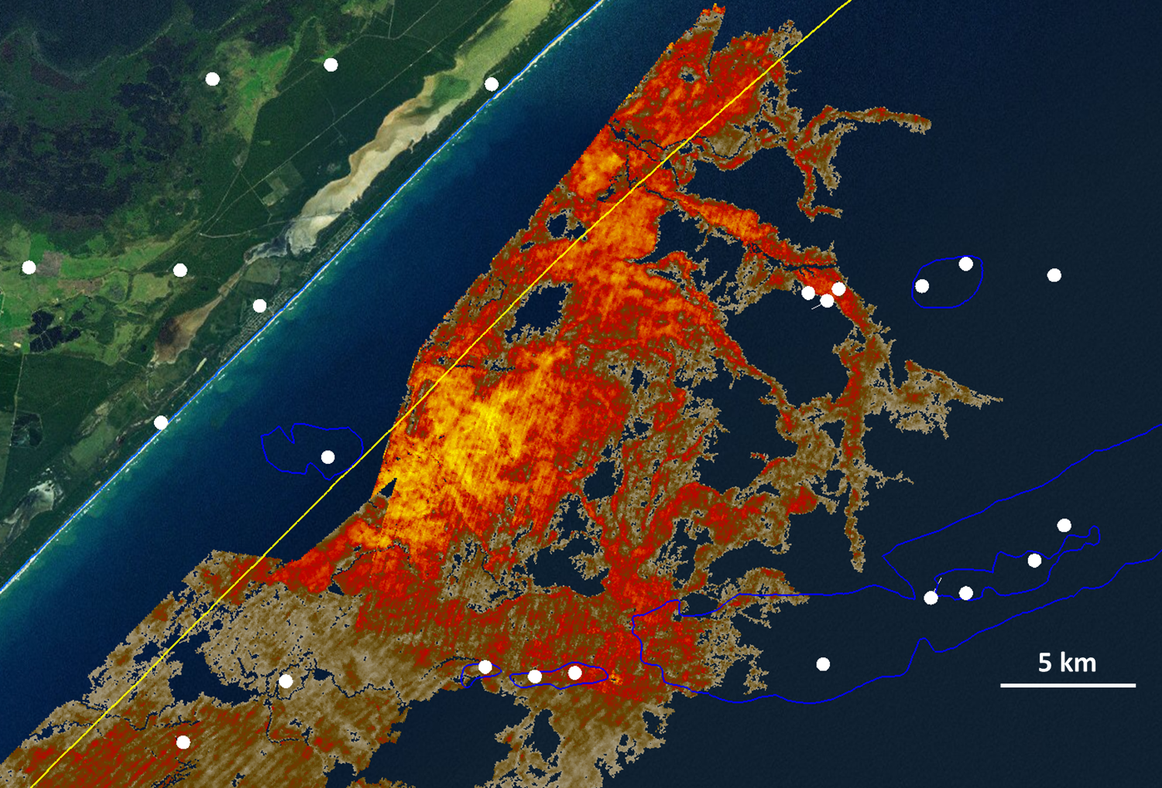
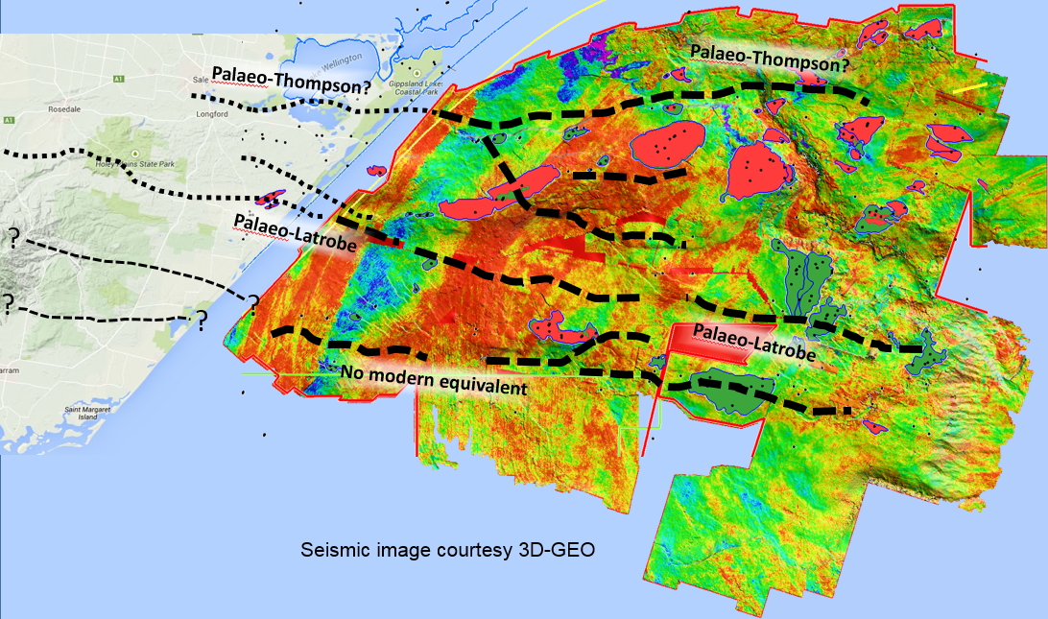
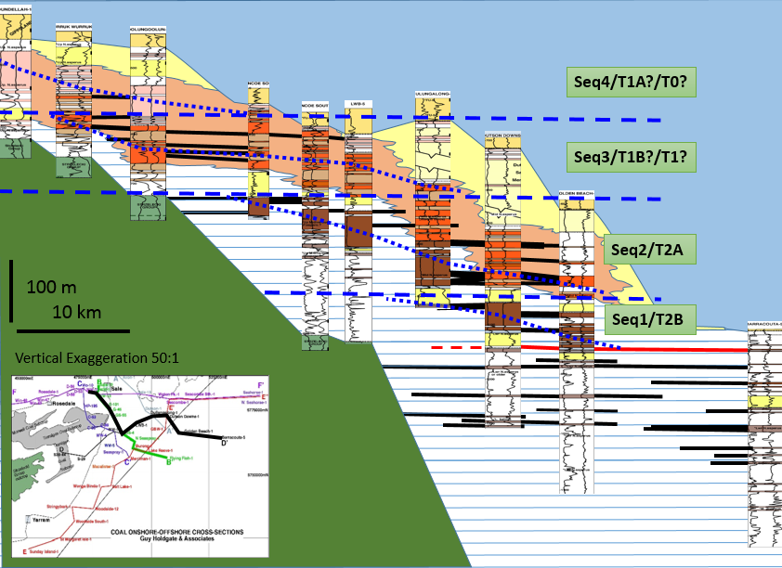
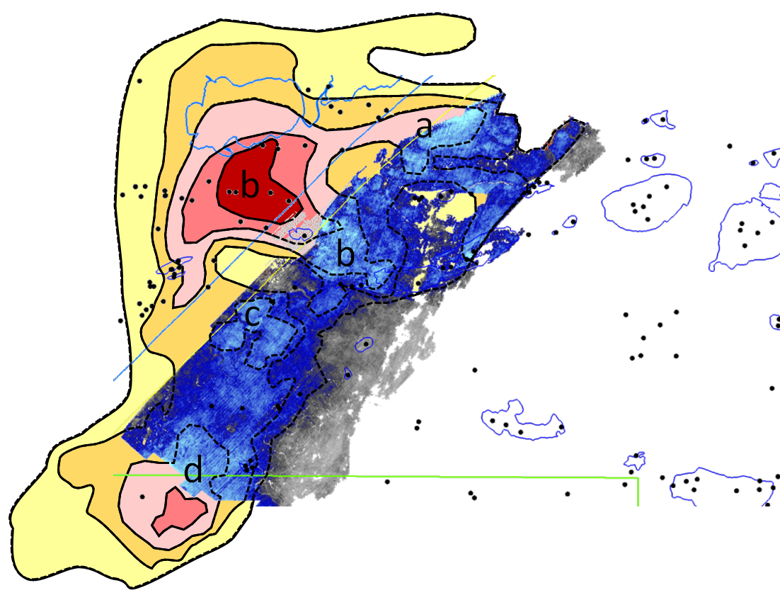
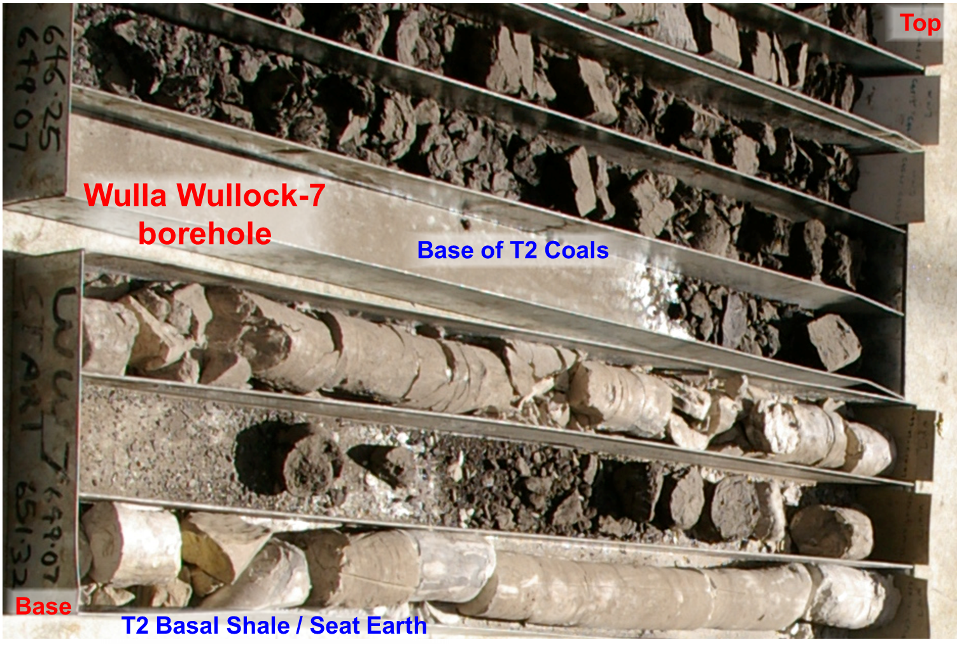
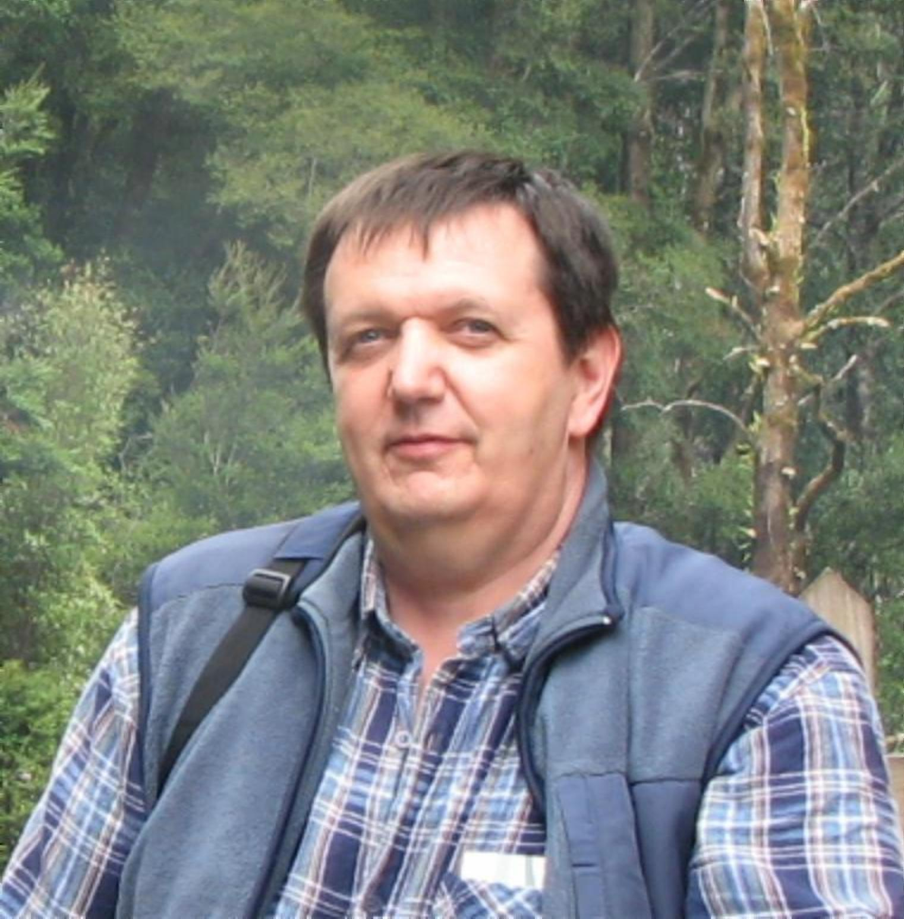
The CarbonNet Project
POSTER B
3D Mapping and correlation of Intraformational seals within the Latrobe Group in the nearshore Gippsland Basin
Figure 10: Occurrences of proven seal across the Traralgon T2 member.
This unit variously acts as a pressure barrier (red circles), a salinity interface (yellow stars) or as a seal for an oil column (green square). At Dolphin field, the T2 acts as a base seal for oil.
Figure 11: Pressure and salinity contrast across Traralgon T2 member at Galloway-1
Extract from Galloway-1 WCR showing operators interpretation of the unit that CarbonNet correlates as T2B, acting as a pressure and salinity barrier.
Figure 12: Middle N. asperus palaeogeography (Traralgon T1/T2)
Palaeogeographic interpretation of finger- and birds-foot deltas building into the Seahorse Lagoon. Note raised bog coals in Golden Beach area (enhanced amplitude through tuning), and offset of barrier bar facies along Mulloway lineament.
Conclusions
The T2 is one member of a family of intraformational seals that can be correlated in wells and mapped on seismic data in the nearshore Gippsland Basin.
These seals represent a robust trapping interface for buoyant fluids, with the capacity to retain columns of hundreds of metres of gas or CO2.
CarbonNet has focussed on the T2 seal interval, which is a proven seal for hydrocarbons within 20 km of the coastline.
Detailed maps of seal and reservoir fairways allow the definition of low-risk trapping opportunities at sites throughout the nearshore.
CarbonNet is investigating a shortlist of three sites in this nearshore area, and plans injection of up to 125 Mt of Co2 into traps beneath the T2 seal.
Site investigation is ongoing and Appraisal activities are being planned at present.
T2 Seal in the nearshore
The T2 coal acts as a seal to hydrocarbons in several wells in the nearshore (Figure 10) and is a pressure and salinity barrier between aquifers above and below T2 (Figure 11).
3D Mapping
Excellent quality open-file marine 3D data allows mapping of fine details of sand body development, the extent of coal swamps, and likely seal and reservoir fairways (Figures 12-16).
T2 Correlation and mapping
The T2 can be correlated in numerous nearshore wells – both onshore and offshore, and subdivided to a series of transgressive parasequences (Figure 16). A T2B isopach has been constructed from offshore 3D and 2D seismic data, and onshore coal boreholes and petroleum exploration wells (Figure 17)
T2B (Figure 18) represents an important seal in the nearshore zone of interest to CarbonNet and is well-developed in several offshore sites that are being studied for carbon sequestration.
Image: Google Earth
2 km
Figure 13: The Mitchell river “silt jetties”
The modern-day Mitchell River in the onshore Gippsland Lakes has built a ~ 10 km finger delta down the west side of Jones Bay, from the town of Bairnsdale towards Paynesville, and then eastwards across Lake King.
Figure 14: Middle N. asperus finger- and birdsfoot deltas
These sand units underlie the T2 coals and be readily mapped on high quality marine 3D data. Isolated sand stringers have strong amplitudes (orange) while within coal-rich zones, amplitudes are suppressed (grey) when sands are present.
Figure 15: Palaeo river systems of the Latrobe Group
Interpreted persistent fluvial systems within the Latrobe Group. Coloured surface is seismic response (amplitude) at top Latrobe Group from which some of the evidence for channel location is drawn. Red corresponds to barrier-bar sands, green and blue to shale and coal. The Palaeo-Latrobe is the axial system in the basin. Two flanking systems feed along fault lineaments to the south and north. Other evidence comes from intra-Latrobe seismic response and well data (not shown)
Figure 16: Onshore-offshore correlation of the Traralgon coal sequences in the nearshore Gippsland Basin
A provisional correlation of the Traralgon coal sequences in the nearshore Gippsland Basin (+25 km from shoreline). Four parasequences are identified, each transgressive, commencing from a basal (forced?) regression. T2B is the first of these sequences and the overlying ones may be assigned to T2A, T1B and T1A or alternatively to T2A, T1, and T0. Further work is required to rationalise this correlation. Depositional environment is flagged as coloured backdrop (blue, marine; yellow, paralic; orange, estuarine, and white, fresh water). Strzelecki “basement” is indicated in green. Major correlation lines are included but for clarity of the background environment, not all coals are highlighted.
Figure 17: T2 member isopach – CarbonNet key nearshore seal
A compilation of 3D seismic amplitude (blue colours), CarbonNet 2D isopachs on the southern margin, and borehole isopachs, modified after Holdgate et al. (2000). Four depocentres of the Traralgon T2 sequence are identified (a to d), between zones of fluvial throughput (not marked, but identifiable from isopach thins and amplitude drop-out).
Dr. Nick Hoffman: CarbonNet Geoscience Storage Advisor
The CarbonNet Project
CarbonNet is run by the State Government of Victoria, with funding support from the Federal government under the Greenhouse Gas Flagships Programme and from the GCCSI.
Figure 18: Traralgon T2B Basal Shale Seal in Core
Coal Borehole Wulla Wullock-7 intersected and cored a good quality section of the T2B basal shale, interpreted as a seat earth from evidence of plant rootlets and leaf imprints, and basal location to the T2B coal.
About the Author
Dr. Nick Hoffman has over 25 years’ international oil industry experience, including substantial time with BP in Europe, and with BHP in Australia and worldwide.
He joined CarbonNet in 2011 as part of the start-up technical team to lead the geoscience evaluation over CarbonNet’s portfolio of nearshore CO2 sequestration targets. He is an expert geophysicist, sequence stratigrapher, and basin geologist with significant experience interpreting depositional environments, structural evolution, and reservoir distribution from 3D and 2D seismic, and from well data. Nick integrates a wide range of basin data to understand the implications for long-term safe CO2 storage. Email: nick.hoffman@ecodev.vic.gov.au
www.energyandresources.vic.gov.au/carbonnet

