Slide 1
How to do EOR offshore, Brazil case study
Paulo Negrais Seabra, Ph.D.
International Workshop on Offshore Geologic CO2 Storage - 19-21 April 2016
Gulf Coast Carbon Centre, University of Texas at Austin

Slide 2
Outline
Brazilian Oil and Gas Industry at a Glance
Pre-Salt Development
CO2 Management
Final Remarks

Slide 3
Outline
Brazilian Oil and Gas Industry at a Glance
Pre-Salt Development
CO2 Management
Final Remarks

Slide 4
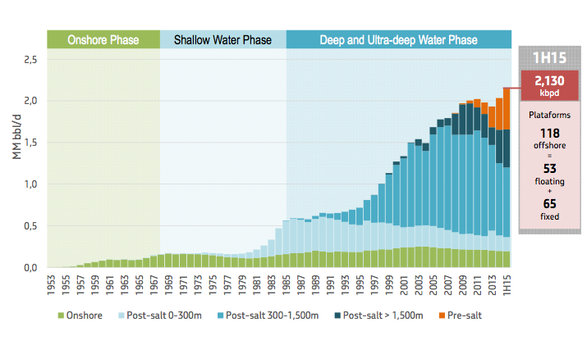
Evolution of Brazilian Oil Production
Source: “Petrobras Update Oct 2015”, presented at BTG Pactual VI Latam CEO Conference - New York, (http://www.investidorpetrobras.com.br/en/presentations/general-presentations)

Slide 5
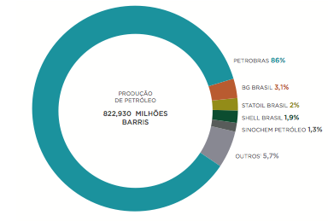
Brazilian Annual Oil Production - 2014
Source: Brazilian National Agency of Petroleum, Natural Gas and Biofuels (ANP), “Statistical Yearbook 2015” (http://www.anp.gov.br/?id=548)

Slide 6
Outline
Brazilian Oil and Gas Industry at a Glance
Pre-Salt Development
CO2 Management
Final Remarks

Slide 7
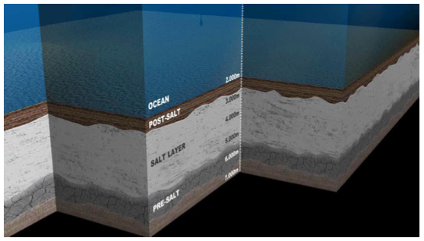
Pre-Salt
• Huge reservoirs (carbonates) of oil and natural gas (recoverable reserves of 8.3 billion BOE);
• Between 5,000 and 7,000 m below sea level;
• ~ 300 km off the coast;
• Water depth ~ 2,000 m;
• Salt layer with more than 2,000 m thick, in some areas;
• Light oil (30° API), hight GOR (> 200), and valiable CO2 content (between 1 and 20%)
Source: HAYASHI, M.Y.,“Brazilian Pre-salt Update May 2015”, presented at Citi Global Energy & Utilities Conference (http://www.investidorpetrobras.com.br/en/presentations/general-presentations)

Slide 8
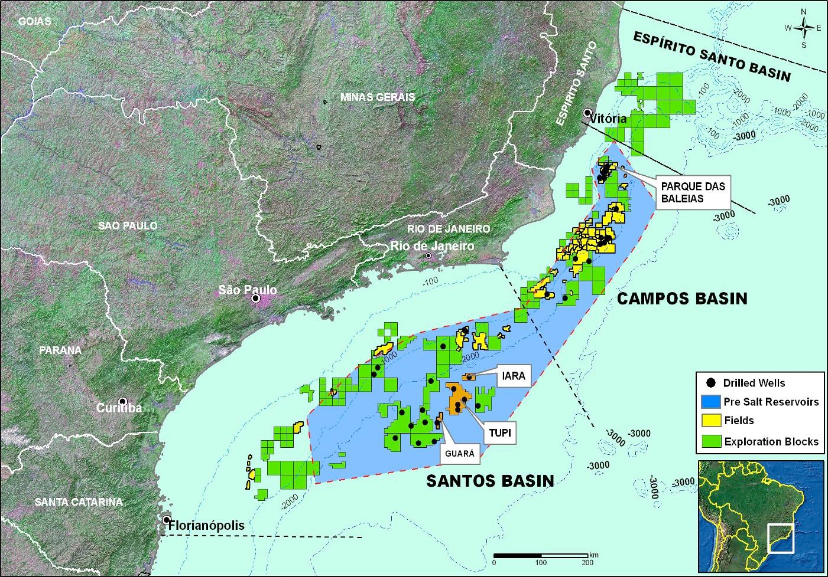
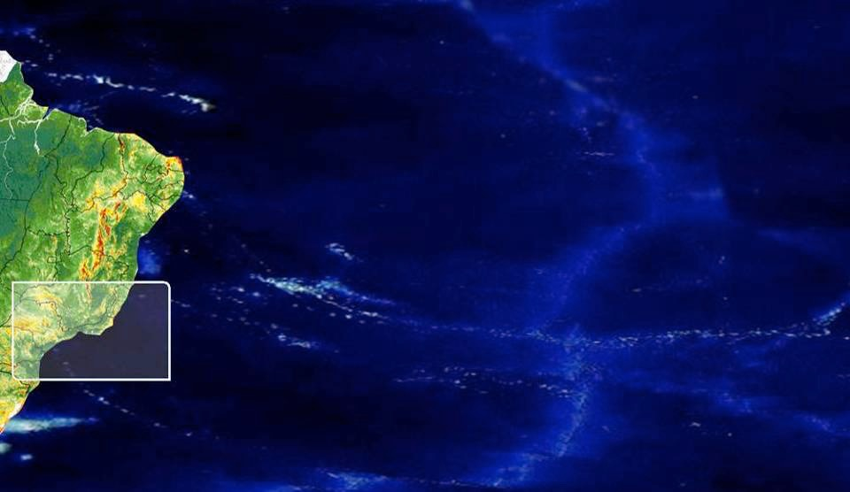
Pre-Salt Province
LULA
Total area = 149,000 km2; area already under concession= 30.6%; 26.6% with Petrobras interest
Source: SEABRA & GRAVA “Petrobras’ Offshore CO2 Management – Pre-salt development management”, presented at 2014 COP 20 Side Event - Lima, Peru (http://www.ieaghg.org/docs/presentations/COP_20_-_Side_Event_Petrobras_Public.pdf)

Slide 9
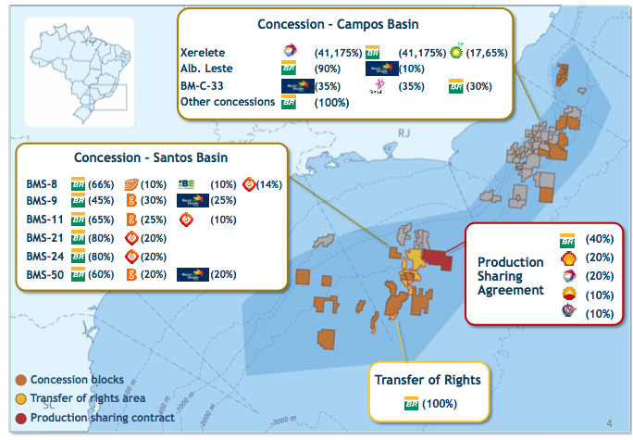
Pre-salt Province, Regimes and Partners
Source: “Petrobras Update Oct 2015”, presented at BTG Pactual VI Latam CEO Conference - New York (http://www.investidorpetrobras.com.br/en/presentations/general-presentations)

Slide 10
Key Project Milestones
July 2006: Lula oil field discovered;
May 2009: Extended well tests commenced to study development options for the pre-salt reservoirs;
December 2010: Petrobras filed the Declaration of Commerciality with the Brazilian National Agency of Petroleum, Natural Gas and Biofuel (ANP);
June 2013: Petrobras announced that commercial production from the FPSO Cidade de Paraty had commenced.
Source: Global CCS Institute, “Petrobras Lula Oil Field CCS Project”, (http://www.globalccsinstitute.com/projects/petrobras-lula-oil-field-ccs-project)

Slide 11
Outline
Brazilian Oil and Gas Industry at a Glance
Pre-Salt Development
CO2 Management
Final Remarks

Slide 12
Petrobras Experience on CO2-EOR
(reservoirs < 1,000 m deep)
Source: FORMIGLI, J., “CO2: Challenges & Opportunities”, presented at “2nd Brazilian Congress of CO2 in Oil, Gas and Biofuel Indudtry”, 2013 - Rio de Janeiro, Brasil

Slide 13
Handling of CO2 in the Pre-Salt Hydrocarbon Fluids
Motivation:
High (8 to 20%) CO₂ content in the gas phase in some wells;
Although it doesn't have target obligations to reduce its emissions, Brazil is committed with climate change control;
Accordingly, Petrobras and partners in the pre-salt blocks do not consider to vent the CO₂ associated to the produced gas.
Questions raised:
What is the best way to capture the CO2 in an offshore ultra-deep water environment (2,100 m WD), 300 km from shore?
What is the best option for sequestrating the captured CO2?
Source: SEABRA & GRAVA “Petrobras’ Offshore CO2 Management – Pre-salt development management”, presented at 2014 COP 20 Side Event - Lima, Peru (http://www.ieaghg.org/docs/presentations/COP_20_-_Side_Event_Petrobras_Public.pdf)

Slide 14
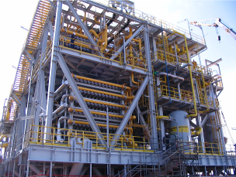
Natural Gas Processing
CO2 content in the fluids address challenges:
- Size & Footprint
- Weight
- Efficiency
Membranes:
- Better for medium or high CO2 content.
- Smaller footprint
- Simple to operate and easy to maintain
- Process a wide range of CO2 in the inlet stream.
FPSO Cidade Angra dos Reis
FPSO Cidade Angra dos Reis, São Paulo, Ilhabela (UOP – spiral wound) and Paraty (Cameron - hollow fiber)
FPSO Cidade Angra dos Reis, São Paulo, Ilhabela and Paraty are all charted
Source: SEABRA, P.N. & GRAVA, W.M. “Petrobras’ Offshore CO2 Management – Pre-salt development management”, presented at 2014 COP 20 Side Event - Lima, Peru (http://www.ieaghg.org/docs/presentations/COP_20_-_Side_Event_Petrobras_Public.pdf)

Slide 15
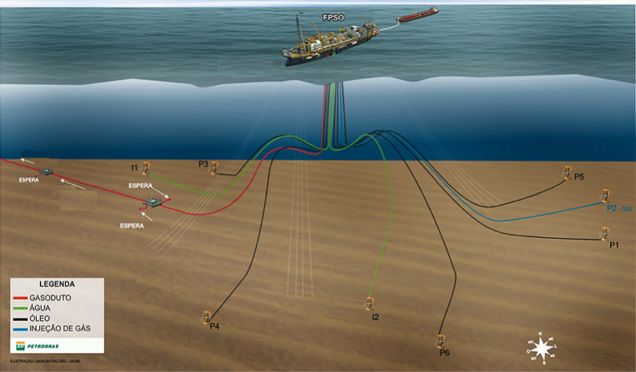
WAG-CO2 EOR
CO₂ Injection for EOR
FPSO
PLET
PLET
Gas Export
WAG Injection
(2 lines)
PLET
CO₂ Injection
Risers
Gathering Lines
Lines
Gas Export
WAG Injection
Gathering Line
CO₂ Injection
Production Wells
Source: SEABRA & GRAVA “Petrobras’ Offshore CO2 Management – Pre-salt development management”, presented at 2014 COP 20 Side Event - Lima, Peru (http://www.ieaghg.org/docs/presentations/COP_20_-_Side_Event_Petrobras_Public.pdf)

Slide 16
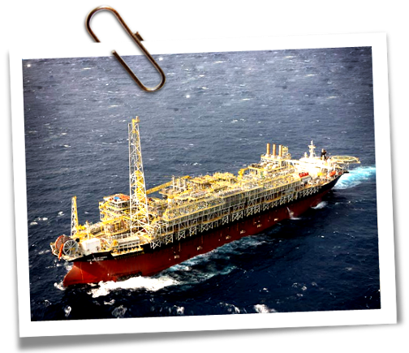
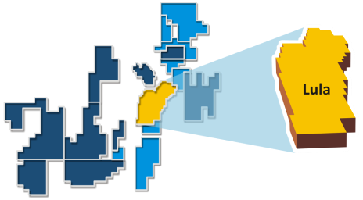
Lula Pilot Production Development
Info
Water depth: 2,149 m (7,050 ft)
1st oil: Oct/2010
100,000 bpd | 5 MM m³/d gas
6 production wells
3 injection wells (gas, water and WAG)
Info
Water depth: 2,149 m (7,050 ft)
1st oil: Oct/2010
100,000 bpd | 5 MM m³/d gas
6 production wells
3 injection wells (gas, water and WAG)
Current data
4 producers: 100,000 bbl/d
1 CO₂ injector: 0,5 MM m3/d.
Exported gas : 4,4 MM m³/d (5% CO₂)
Water Injection started in Oct/12 (WAG)
WAG tested in 2013
Source: SEABRA & GRAVA “Petrobras’ Offshore CO2 Management – Pre-salt development management”, presented at 2014 Side Event COP 20 - Lima, Peru (http://www.ieaghg.org/docs/presentations/COP_20_-_Side_Event_Petrobras_Public.pdf)

Slide 17
Petrobras Contribution for Technological Development - OTC 2015
Source: HAYASHI, M.Y.,“Brazilian Pre-salt Update May 2015”, presented at Citi Global Energy & Utilities Conference (http://www.investidorpetrobras.com.br/en/presentations/general-presentations)

Slide 18
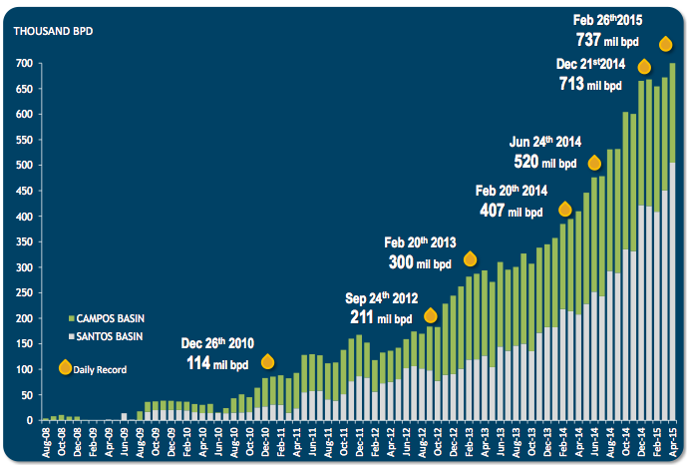
Pre-Salt Production Ramp-up
Source: “Petrobras Update Oct 2015”, presented at BTG Pactual VI Latam CEO Conference - New York (http://www.investidorpetrobras.com.br/en/presentations/general-presentations)

Slide 19
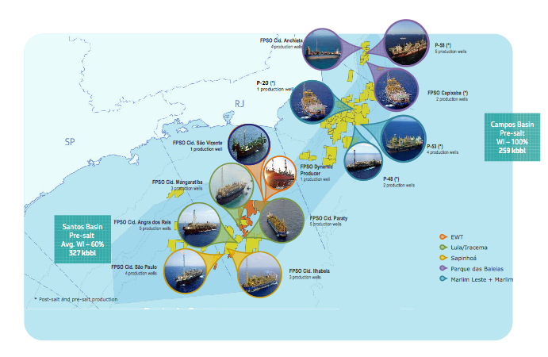
Source: “Petrobras Update Oct 2015”, presented at BTG Pactual VI Latam CEO Conference - New York, (http://www.investidorpetrobras.com.br/en/presentations/general-presentations)

Slide 20
Milestones (2015)
> 1 MM tonnes of CO2 injected;
4 production system (FPSOs) at Santos Basin;
Natural gas production between 5 and 6 MMNm3/d with ~20% CO2;
Natural gas pre-treatment and the CO2 separation using membranes are running with success.

Slide 21
Outline
Brazilian Oil and Gas Industry at a Glance
Pre-Salt Development
CO2 Management
Final Remarks

Slide 22
Final Remarks
Petrobras and partners are committed to reduce the emissions related to the CO₂ produced with the hydrocarbons in the Santos Pre-salt cluster;
Technology is the key factor to address the changing energy environment.

Slide 23
Paulo Negrais Seabra
negrais2010@gmail.com +55 21 996447979
Thank you!

