Slide 1
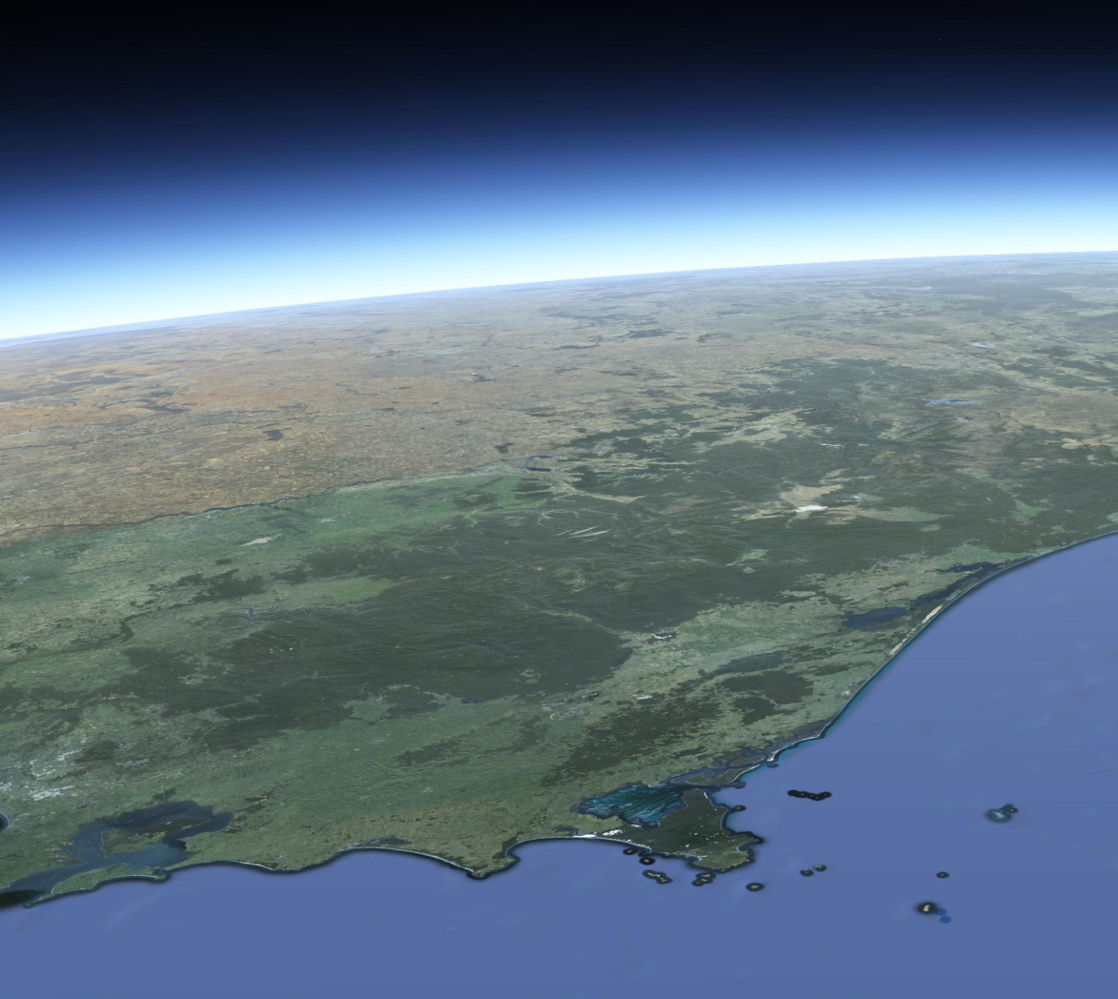
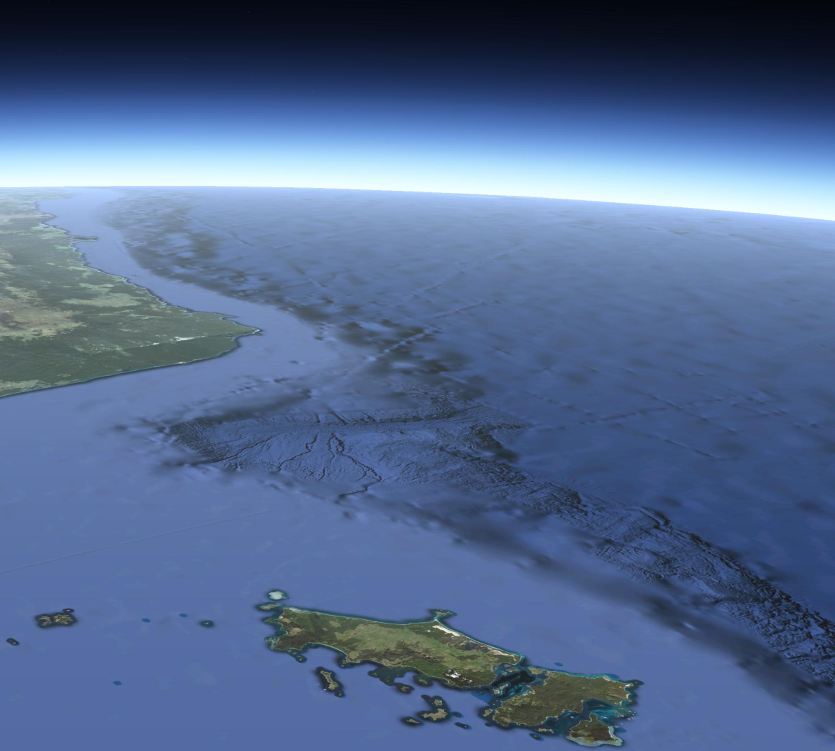
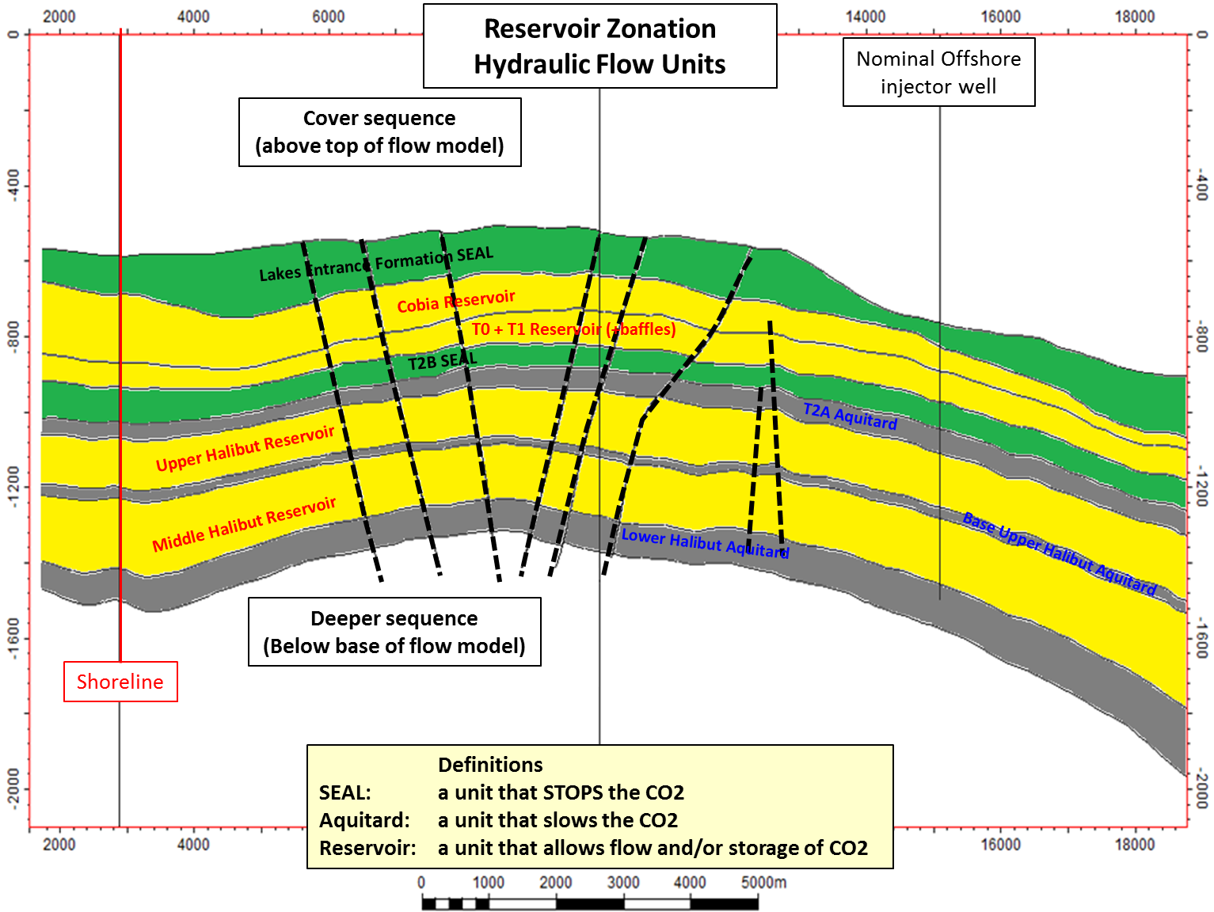
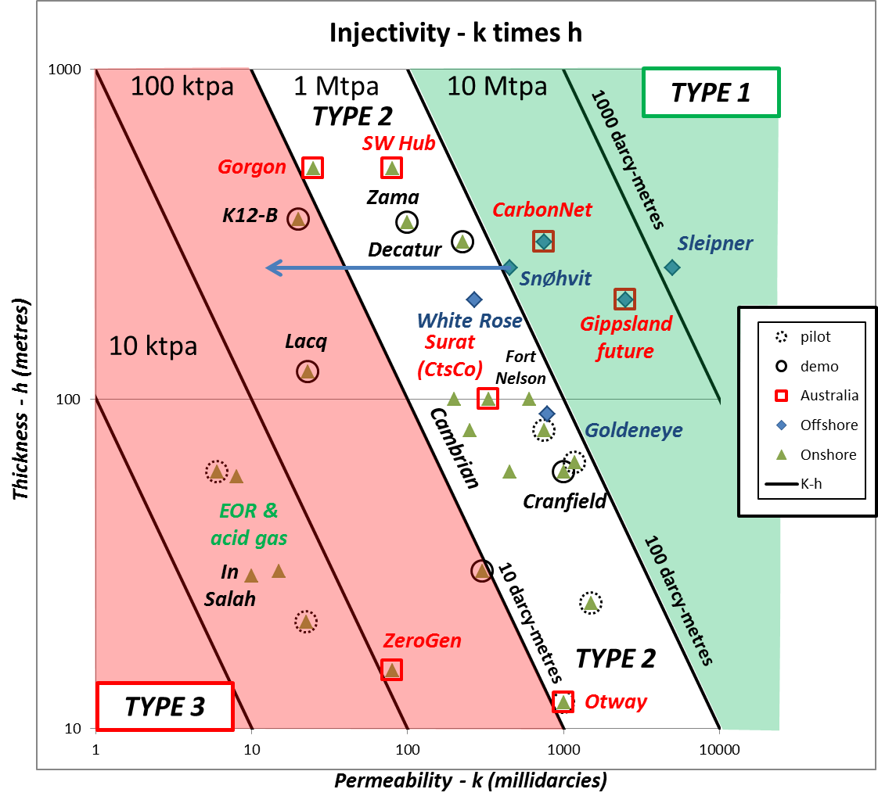
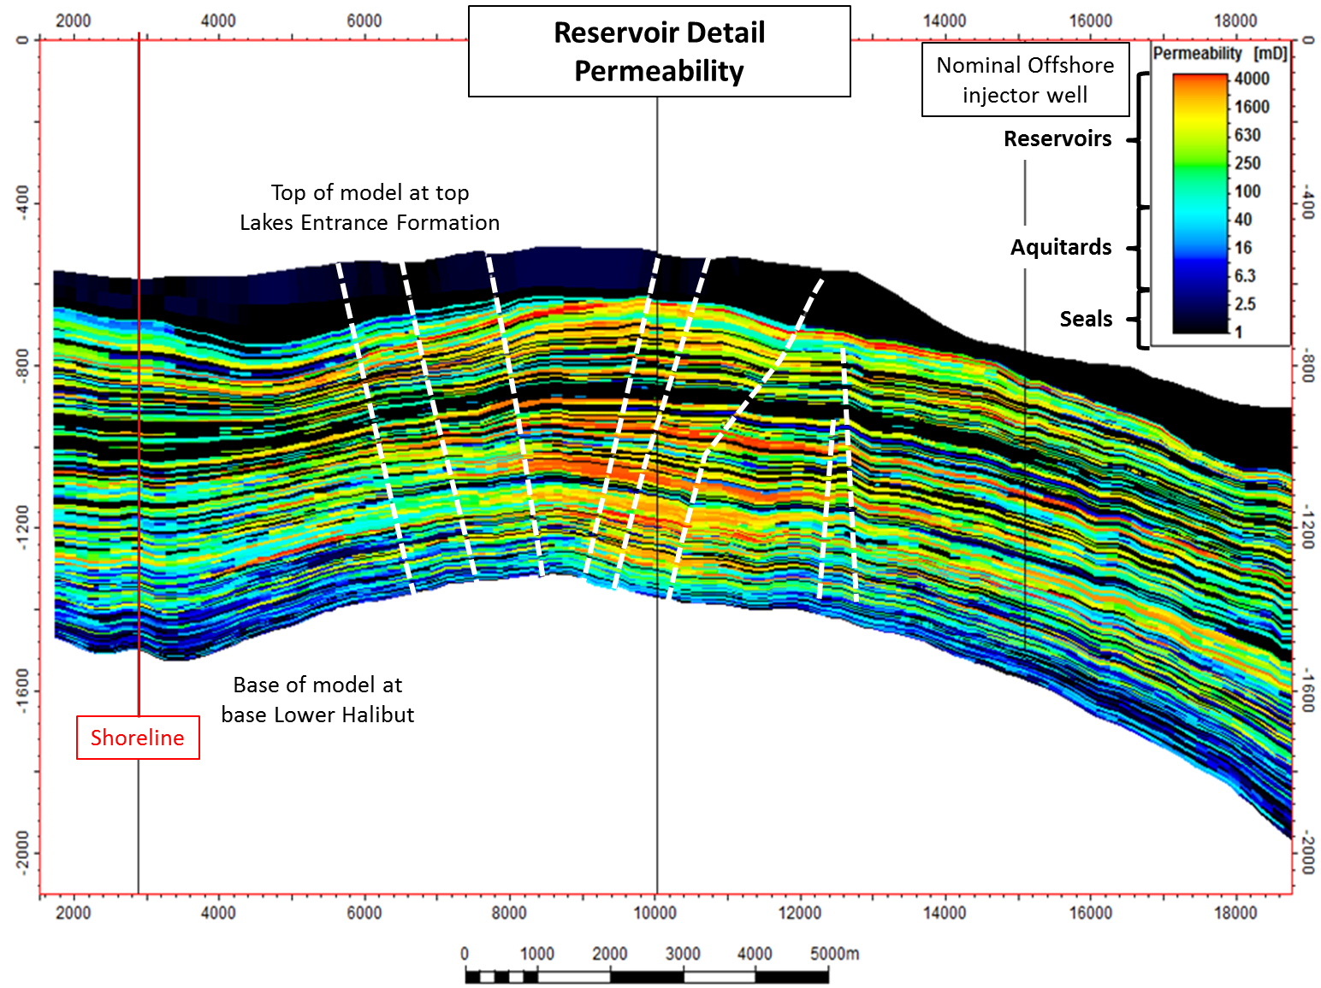
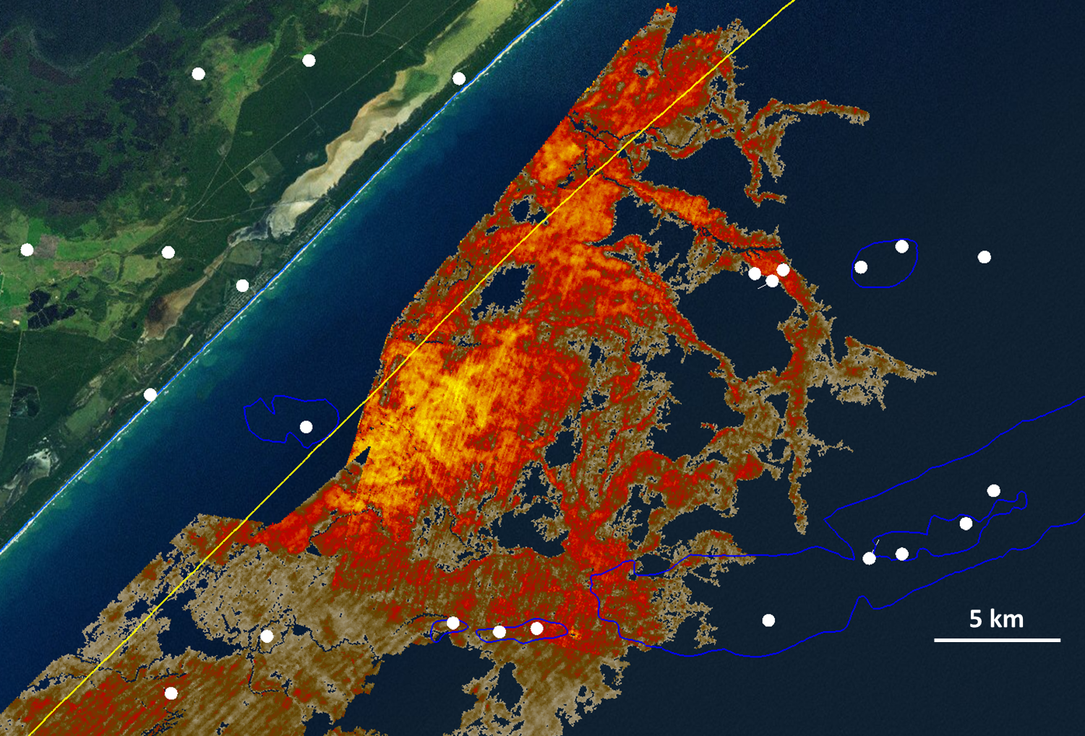
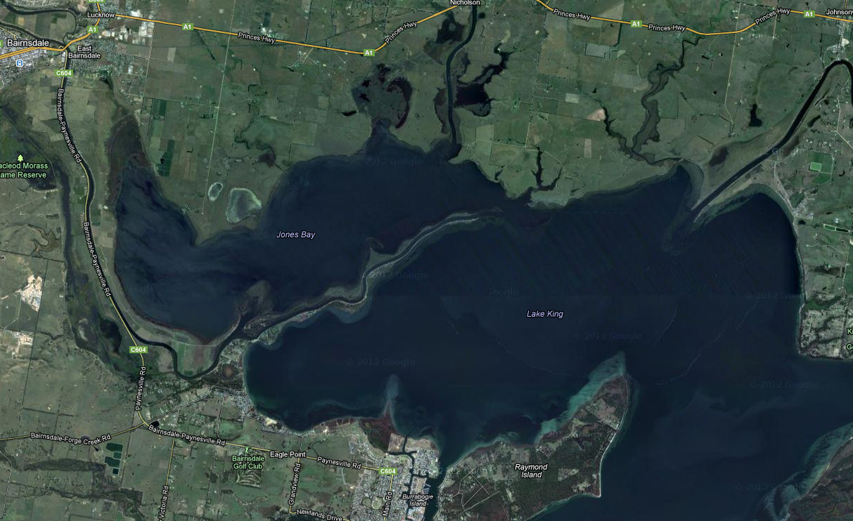
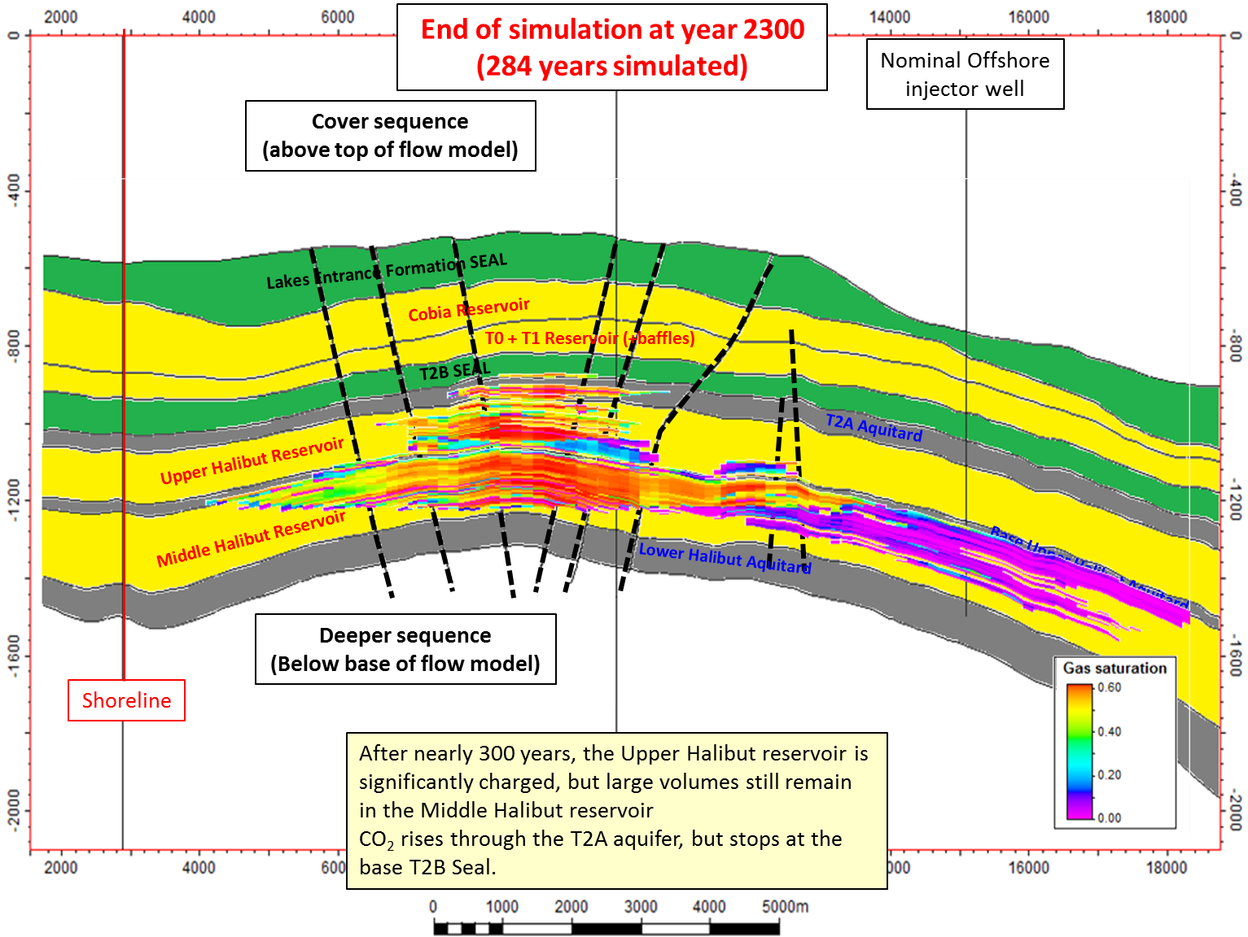
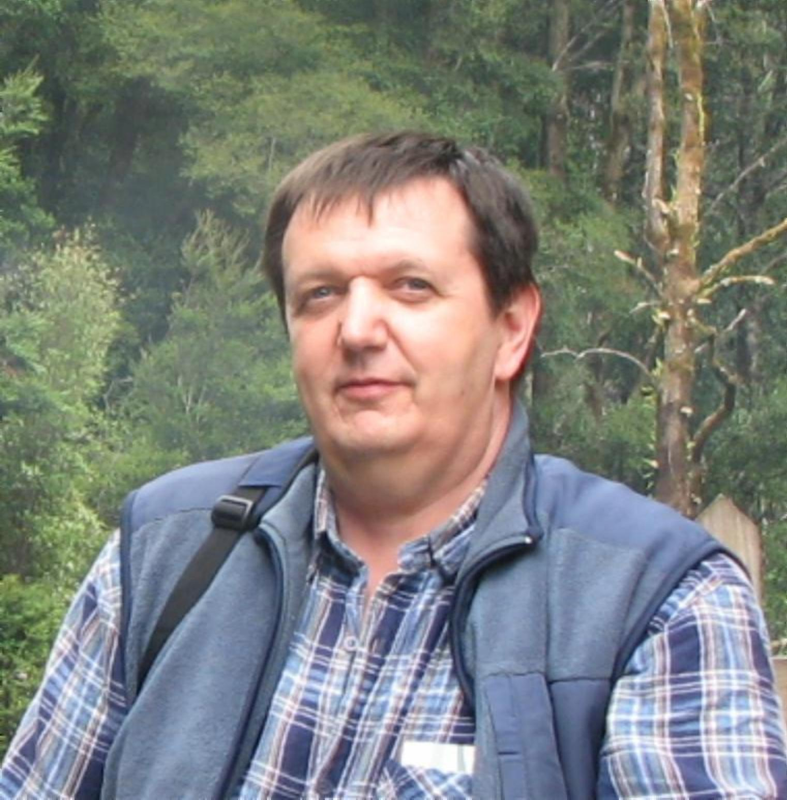
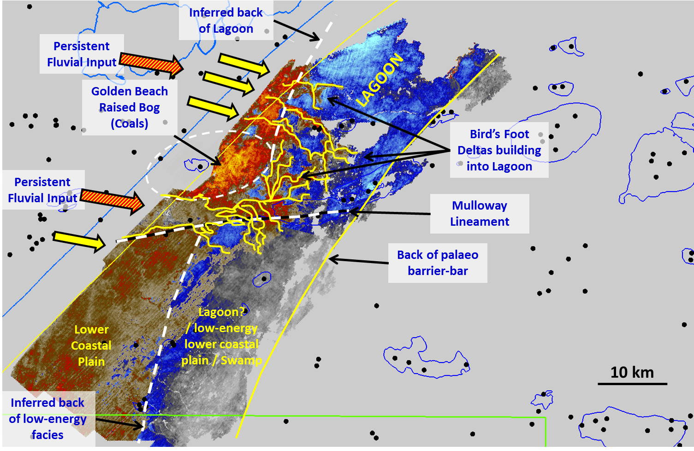
The CarbonNet Project
POSTER B
MMV constraints for shallow-water nearshore storage sites
Figure 9: Reservoir injectivity for CCS projects worldwide.
Injectivity is ultimately controlled by reservoir thickness and permeability. Ideal reservoirs (Type 1) are coloured green, and adequate reservoirs (Type 2) are white. Poor reservoirs (type 3) are red and injection is contraindicated because of risk of fracturing (e.g. In Salah)
Figure 8: Storage concepts.
Extensive
Figure 10: Reservoir detail.
Full 3D geostatic models have been build, using offset and local well data and regional and local geological depositional models. Full CO2 flow simulation has been completed for injection rates up to 5 Mtpa over 25 years (i.e. 125 Mt total injection)
CarbonNet storage concepts
CarbonNet has shortlisted a suite of three sites with different characteristics – two structural traps, and one aquifer trap. These range in capacity from 25 Mt to 125 Mt and involve storage at a variety of stratigraphic levels (Figure 8).
Reservoirs of the Latrobe Group are world class with injectivity of over 100 Darcy-metres (Figure 9). This is comparable to the injectivity of the Utsira formation at the Sleipner site. Excellent aquifer support in this basin allows primary oil recovery of 85% with no water injection. Similar pressure response will allow large-volume injection without any geomechanical issues.
The most promising structures have been modelled in detail (Figure 10) and offer storage of Supercritical CO2 at depths of 1000m and greater, beneath intraformational seals (Figure 11).
Other sites involve storage beneath the Lakes Entrance Formation – the regional seal proven by decades of petroleum exploration.
High quality 3D seismic data (Figure 12) and excellent in-situ examples of modern depositional environments (Figure 13) allow direct imaging of the geological features that form reservoirs and seals (Figure 14).
MMV
The presence of multiple high-quality seals offers very high storage certainty. The primary method of MMV will be conventional marine 3D seismic to image the top and edges of the plume, within structural closures and along plume migration paths.
3D seismic will deliver confidence in storage, and also act as an above-zone monitoring tool to demonstrate that no part of the CO2 rises above the topseals. This seismic data will be supplemented by strategically-sited monitor wells measuring injection zone and above-zone pressure, temperature, chemistry, and rock physics.
Marine MMV will serve as an assurance monitoring tool to demonstrate that no CO2 has reached the marine environment.
Certification
Det Norske Veritas have certified the CarbonNet Portfolio of three sites against the requirements of Recommended Practice DNV-RP-J203. In addition, the Appraisal Plan for the prioritised site, drafted by Schlumberger Carbon Services, has also been verified against DNV-RP-J203 and against the requirements of Australian legislation.
Figure 12: Middle N. asperus finger- and birdsfoot deltas
These sand units underlie the T2 coals and be readily mapped on high quality marine 3D data. Isolated sand stringers have strong amplitudes (orange) while within coal-rich zones, amplitudes are suppressed (grey) when sands are present.
2 km
Figure 13: The Mitchell river “silt jetties”
The modern-day Mitchell River in the onshore Gippsland Lakes has built a ~ 10 km finger delta down the west side of Jones Bay, from the town of Bairnsdale towards Paynesville, and then eastwards across Lake King. These modern systems are direct analogues of the Latrobe Group depositional system, and are the longest finger deltas outside of the Mississippi region
Dr. Nick Hoffman: CarbonNet Geoscience Storage Advisor
About the Author
Dr. Nick Hoffman has over 25 years’ international oil industry experience, including substantial time with BP in Europe, and with BHP in Australia and worldwide.
He joined CarbonNet in 2011 as part of the start-up technical team to lead the geoscience evaluation over CarbonNet’s portfolio of nearshore CO2 sequestration targets. He is an expert geophysicist, sequence stratigrapher, and basin geologist with significant experience interpreting depositional environments, structural evolution, and reservoir distribution from 3D and 2D seismic, and from well data.
Nick integrates a wide range of basin data to understand the implications for long-term safe CO2 storage. Email: nick.hoffman@ecodev.vic.gov.au
Figure 11: Plume simulation after ~300 years
In structural storage sites, the plume is fully contained within the structural closure at all times and safely trapped below effective seals for 1000+ years (300 year timestep illustrated here)
Figure 14: Middle N. asperus palaeogeography (Traralgon T1/T2)
Palaeogeographic interpretation of finger- and birds-foot deltas building into the Seahorse Lagoon. Note raised bog coals in Golden Beach area (enhanced amplitude through tuning), and offset of barrier bar facies along Mulloway lineament.
The CarbonNet Project
CarbonNet is run by the State Government of Victoria, with funding support from the Federal government under the Greenhouse Gas Flagships Programme and from the GCCSI.
www.energyandresources.vic.gov.au/carbonnet

