Slide 1
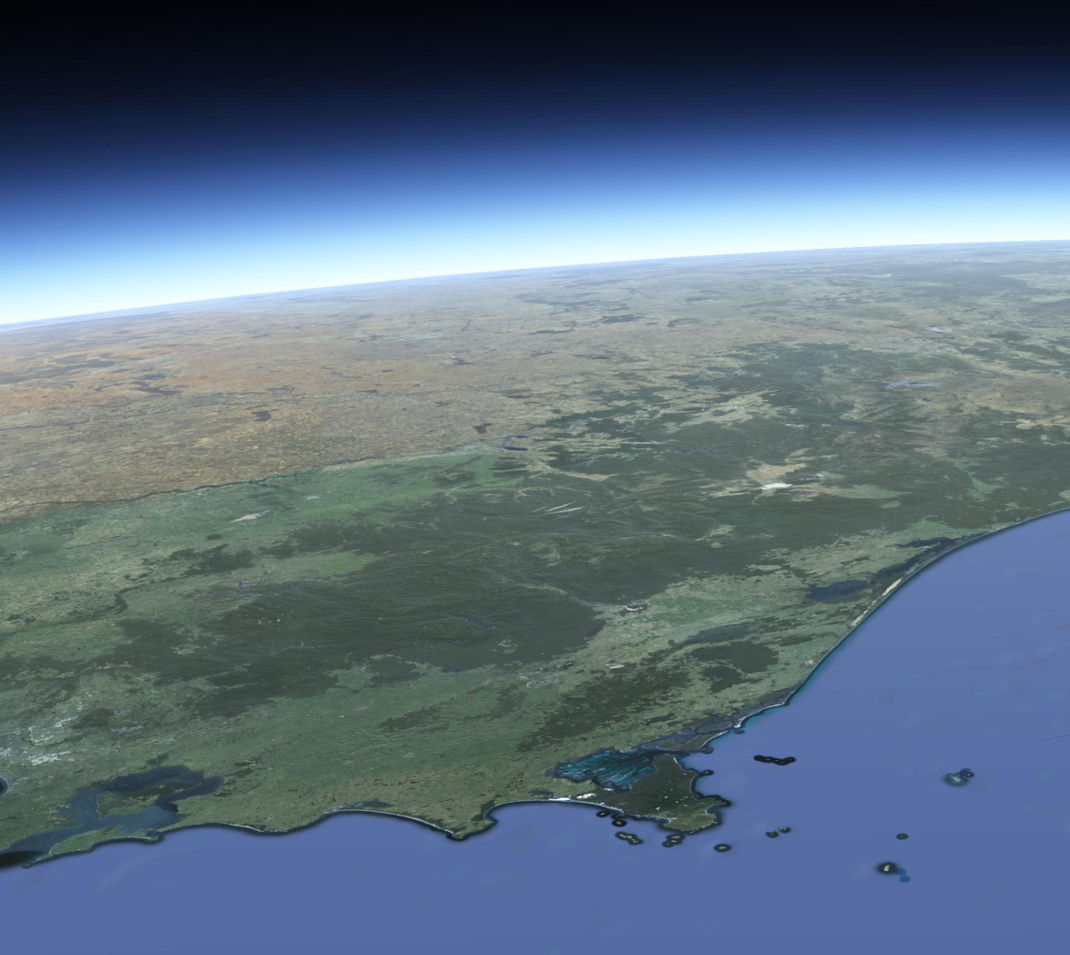
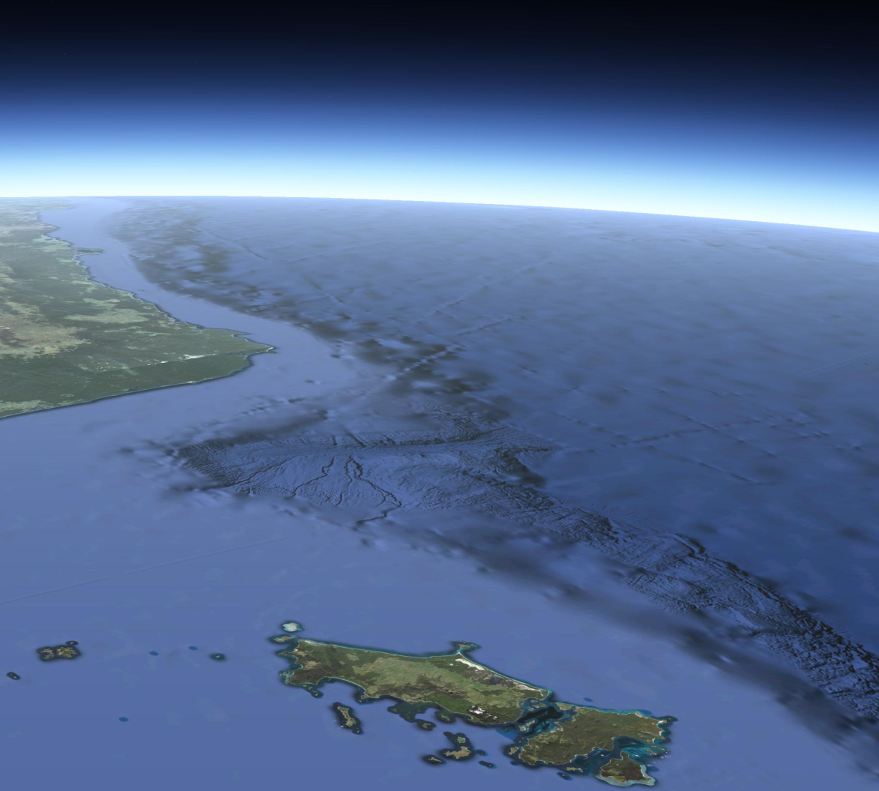
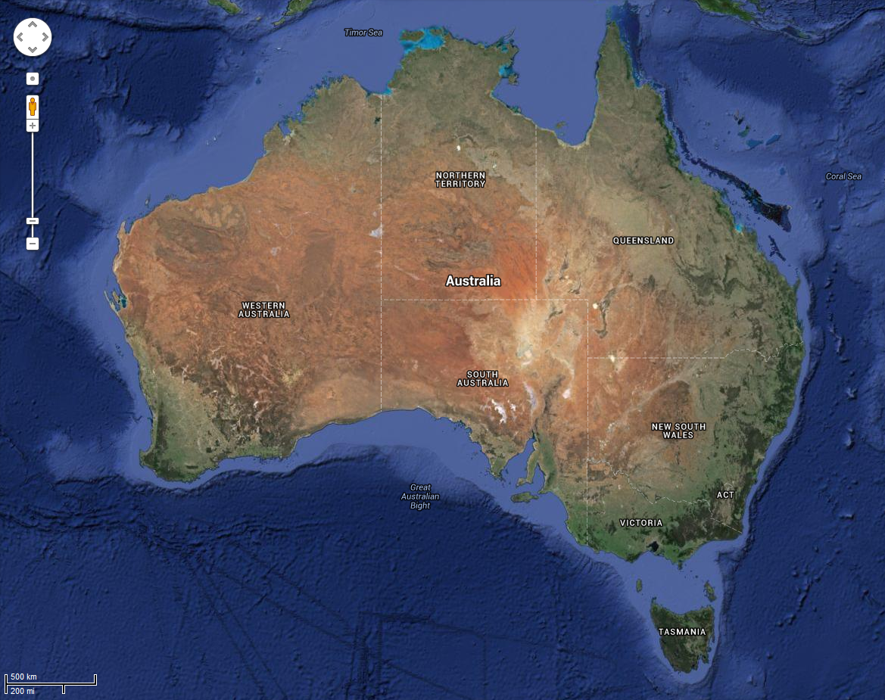
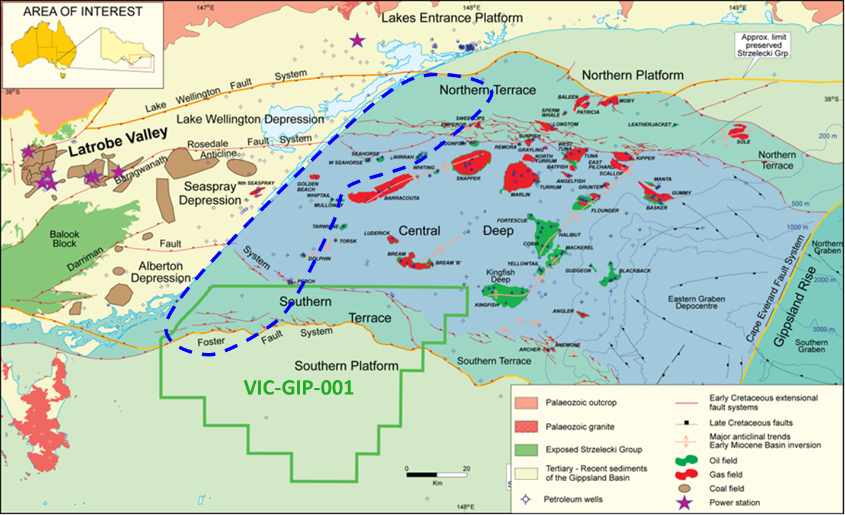
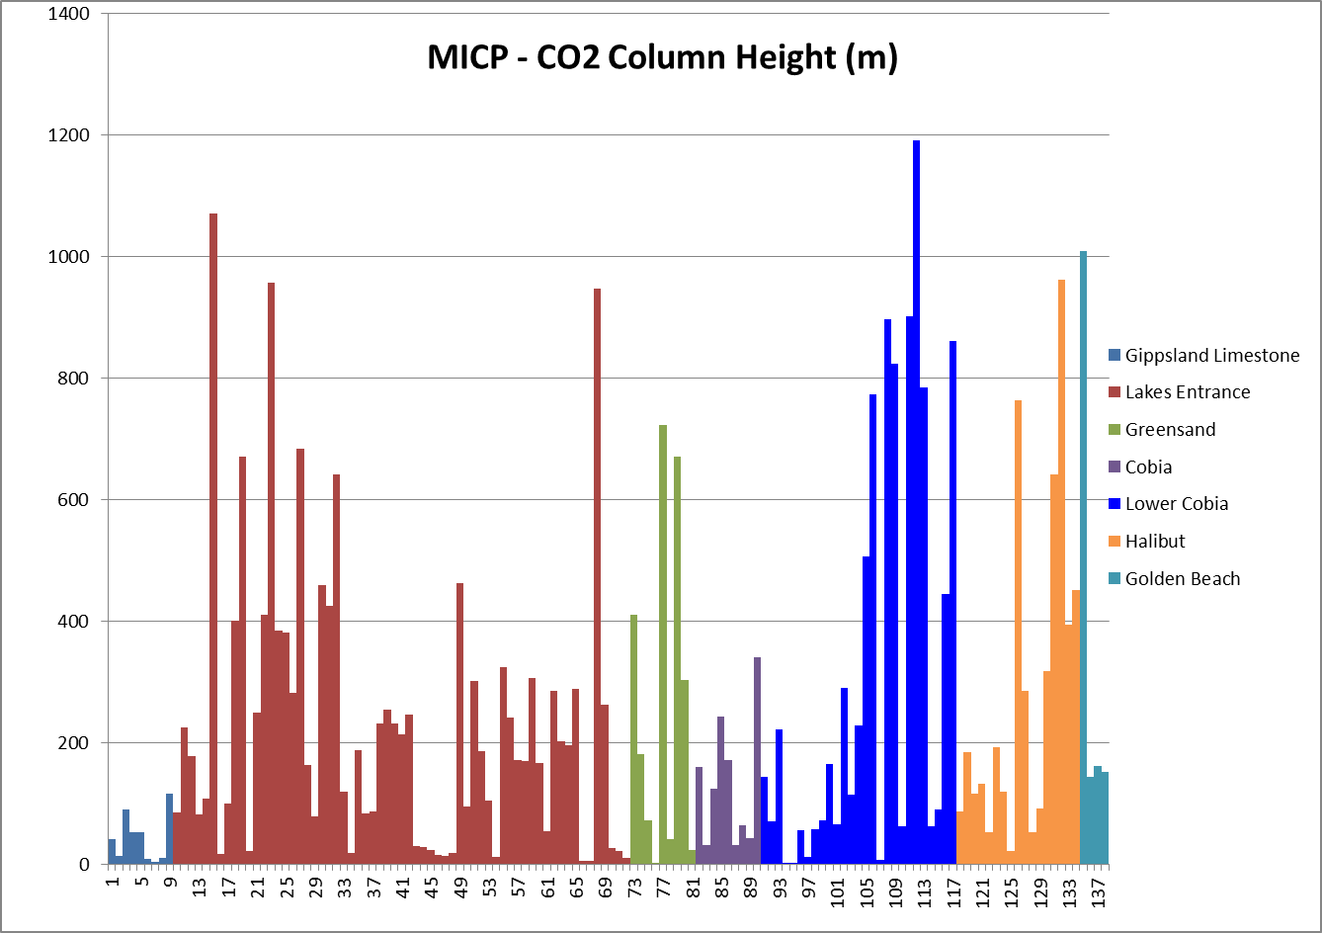
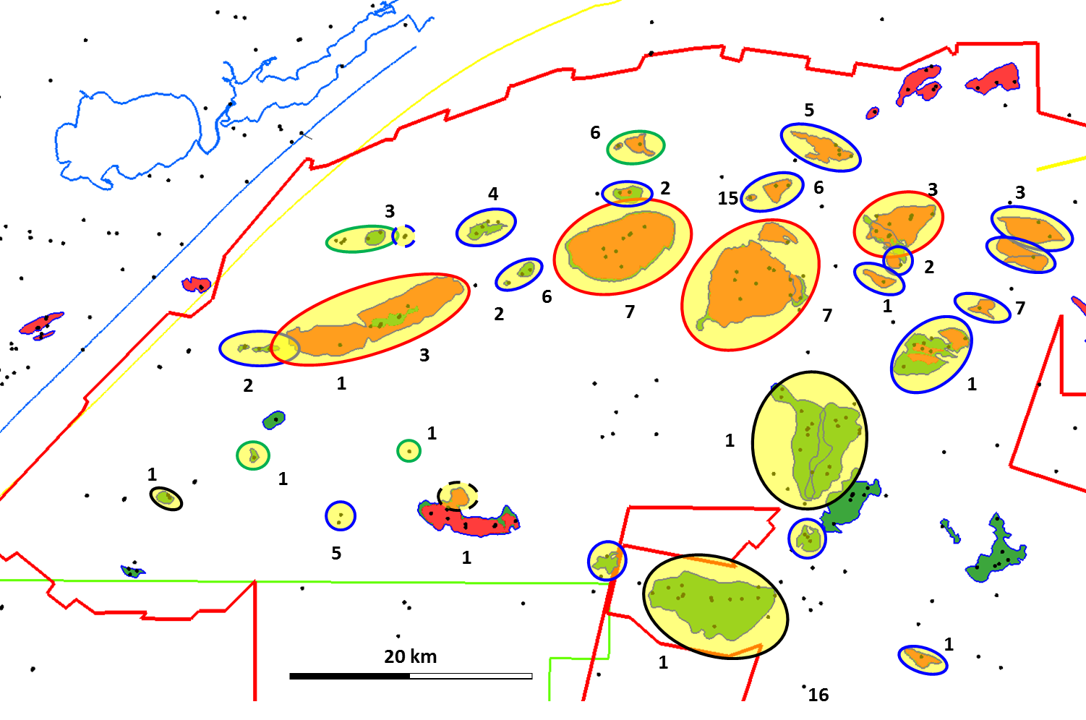
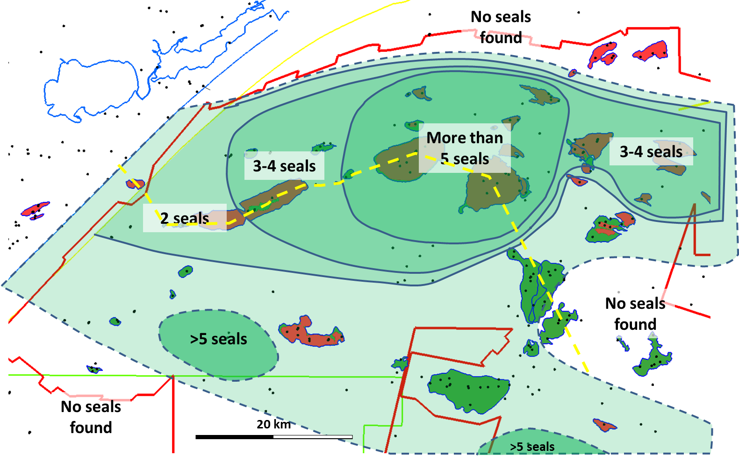
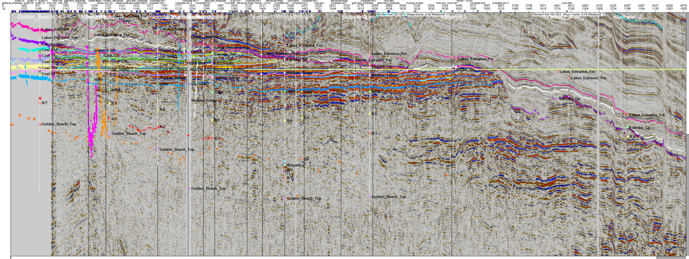
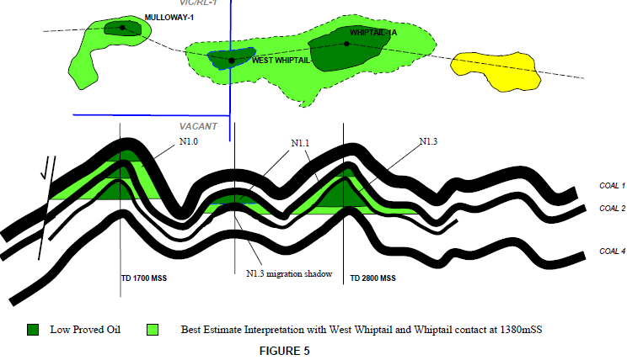
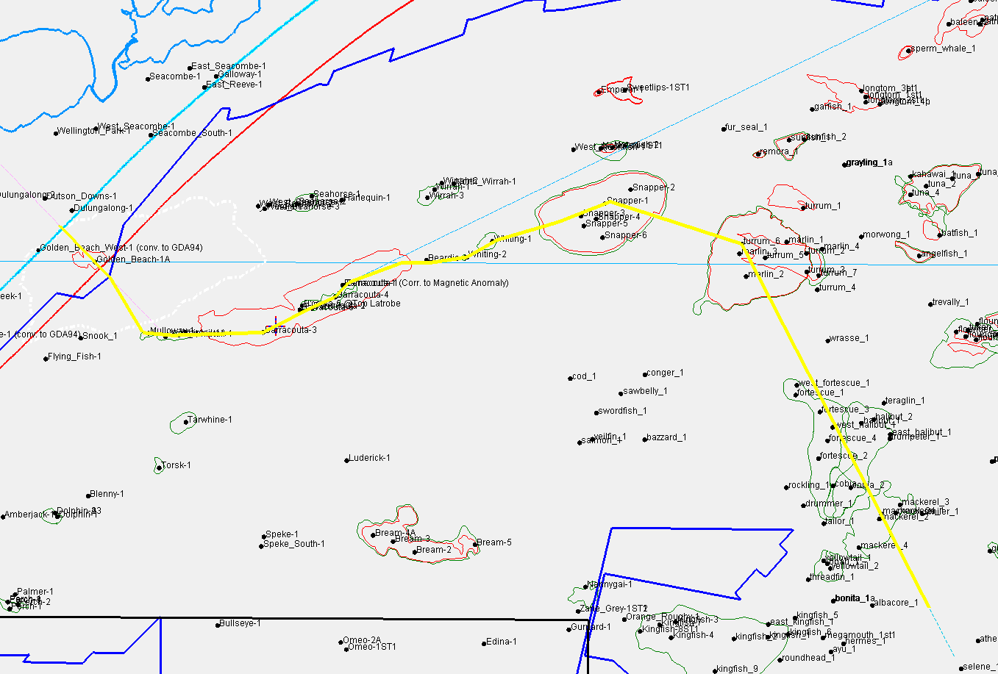
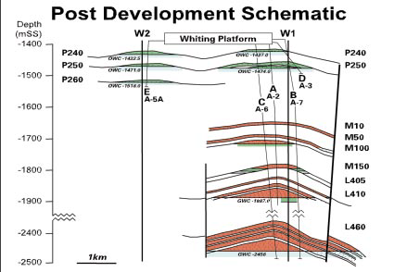
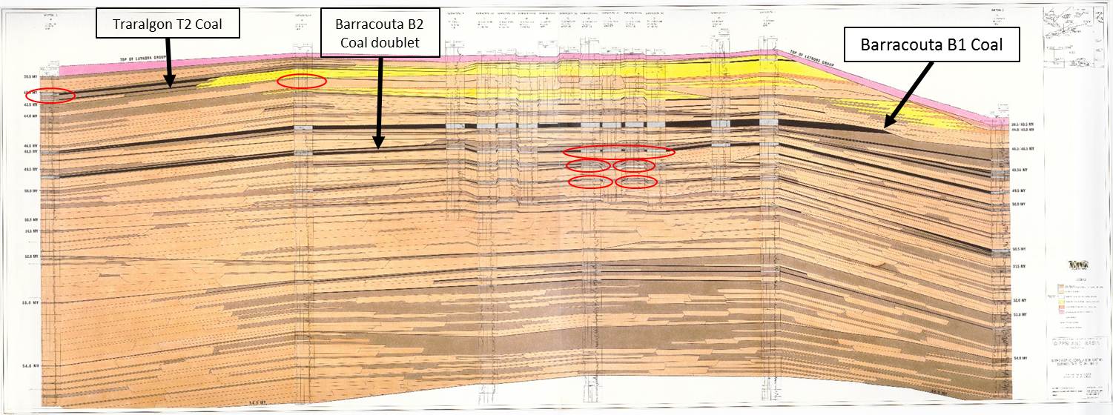
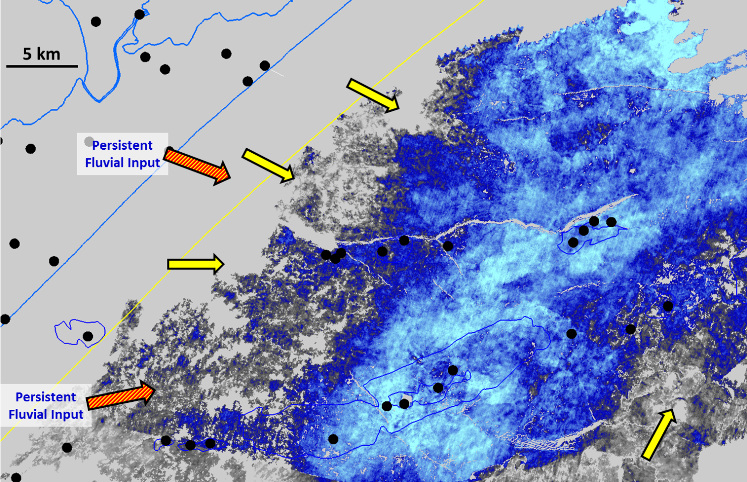
The CarbonNet Project
POSTER A
3D Mapping and correlation of Intraformational seals within the Latrobe Group in the nearshore Gippsland Basin
Index Map:
Location of Gippsland Basin in Victoria, Australia
Image: Google Earth
Figure 1: Basin Map.
The CarbonNet area of interest (blue dashed line) covers the nearshore Gippsland Basin out to approx 25 km from the coastline, but avoiding major hydrocarbon accumulations. Basin architecture is a classic e-w rift basin with fill of fluvial clastics from the west and a shoreline backstepping over time from the eastern limit of the basin at ~80 Ma to behind the modern (intra-glacial) shoreline at ~25Ma, then advancing to the shelf edge at glacial lowstands. The northern and southern boundaries of the basin are fault-delimited and the rift section is thinned/partially eroded with poorer trapping potential.
Figure 2: MICP data sorted by geological formation for the Gippsland Basin.
The cover sequence of Gippsland Limestone has poor seal capacity. The classic petroleum topseal of Lakes Entrance Fm. is an excellent seal, as is the underlying greensand. Upper Cobia Subgroup seals are poor, but many lower Cobia Subgroup (Traralgon Fm.) seals are again excellent and essentially equal to Lakes Entrance Fm. Some deeper Halibut and Golden Beach Subgroup seals also have merit.
Intraformational Seals in Gippsland Basin
The Gippsland Basin is Australia’s premier petroleum basin and has been explored for over 50 years. Basin reserves exceed 5 billion barrels of oil and 8 Tcf of gas.
Some 20% of petroleum is reservoired at intraformational level within the Latrobe Group. Understanding these intraformational seals is important for future CO2 storage.
The main petroleum seal is the Lakes Entrance Formation, but seals at a variety of deeper levels have equivalent seal capacity (Figure 2). Mulitple seals occur in many wells (Figure 3) and can be mapped across the basin as a seal fairway (Figure 4).
Seismic and well correlations across the basin show a clear link between coal units and seals (Figures 5-7). Seals often occur at the base of coal seams, and are associated with seat earths.
Some seals can sustain over 100m of gas column (Figure 8), and the coals can be readily mapped within the excellent quality 3D seismic available offshore (Figure 9).
Image: Google Earth
Figure 3: Occurrence of intraformational seal fairways in the Gippsland Basin.
The number of intraformational seals proven by petroleum finds in the basin. Each distinct water contact or pressure gradient counts as one column. The pattern is difficult to interpret from this data alone. Coloured ellipses classify the types of intraformational seal: Red – A deeper pool lies below top Latrobe gas; Green – a deeper pool underlies top Latrobe oil; Blue – a deeper pool underlies water-wet top Latrobe; Black – a differential hydrocarbon water contact exists across a field (Dashed for Bream where a fieldwide oil-water contact exists, but gas-oil contact varies)
Figure 4: Map of intraformational seal fairways in the Gippsland Basin.
A contour map of the trend of Figure 3, showing the clear definition of a seal fairway in the northern half of the basin, a deficit of seals along the axis of the basin, and the suggestion of a second seal fairway on the southern margin.
Mulloway Whiptail
Barracouta
West
T2
2 km
Barracouta
East
Whiting
Snapper
Figure 7: Esso Australia Cross section through Mulloway and Whiptail fields showing multiple intraformational seals at T2 coal level (Section is not formally published, but is on Open File)
Turrum
20 km
Figure 5: Backstepping intraformational seals and coal beds in the Latrobe Group.
A flattened seismic section across the axis of the northern seal fairway showing backstepping intraformational seals (yellow ellipses) associated with the landward side of prominent coal reflectors. The area of Figure 6 is shown by the red dashed rectangle.
Figure 8: Esso Australia Cross section through Whiting field showing multiple intraformational seals including 100 m and 120 m gas columns (Section is not formally published, but is on Open File)
Figure 6: Esso Australia Correlation section through Barracouta field
This unpublished well correlation section along the same alignment as Figure 5 shows backstepping intraformational seals (red ellipses) associated with the basal zone of prominent coals (Section is not formally published, but is on Open File)
Figure 9: Seismic amplitude map of the prominent Barracouta “B1” coal.
A clear depocentre is aligned NNE, with a set of sub units aligned more ENE, on the trend of modern pup-up structures (oil and gasfields, outlined in blue). Fluvial inputs can be mapped by degradation of the coal amplitude and the identification of channel forms and meander belts
www.energyandresources.vic.gov.au/carbonnet

